Slide 1
Community Energy Groups
Climate Change Team Blackburn with Darwen Borough Council

Slide 2
What are community energy groups
Resident/community owned energy networks and projects
Social enterprise in nature, all profits is used to develop the community, and tariffs are usually cheaper if applicable
Usually aimed at delivering green energy at affordable cost to the community and clinics for household energy related issues

Slide 3
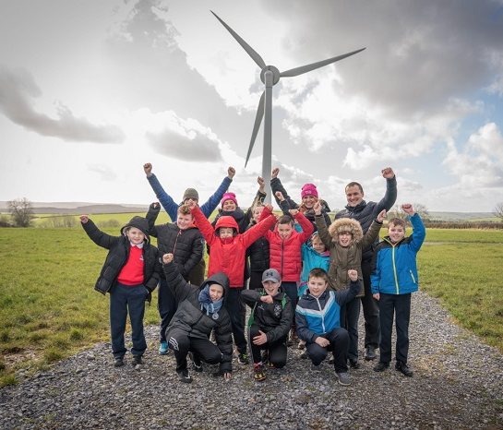
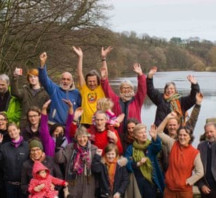
What community energy groups do
Renewable energy generation
Energy advice services
Community heat generation
Community energy efficiency & retrofit services
Retaining profits for community development in response to needs

Slide 4
Impacts & benefits
Cheaper and greener energy for the community
Boosts local economy, creating jobs and improved livelihoods
Warmers homes at affordable rates reducing fuel poverty
Building community trust, corporation and cohesiveness
Smart and ethical investment
Energy related advice and support

Slide 5
Challenges & solutions
Volunteer led – may lack skills or capacity
Lots of guidance & advice available – NW Net Zero Hub, Community Energy England
Potentially high grid connection costs
Power Purchase Agreements to lessen costs
Planning permission challenges
Local planning guidance to help (Low Carbon & Renewable Energy Supplementary Planning Document)
Need for development & feasibility funding
Lots of grants available – Centre for Sustainable Energy, Ashden, NW Net Zero Hub

Slide 6
How to start a community energy group
Get inspired! See what is happening around you
Know your project options
Find and get all the support you need
Connect with other community energy groups and national bodies

Slide 7
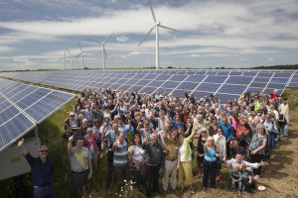
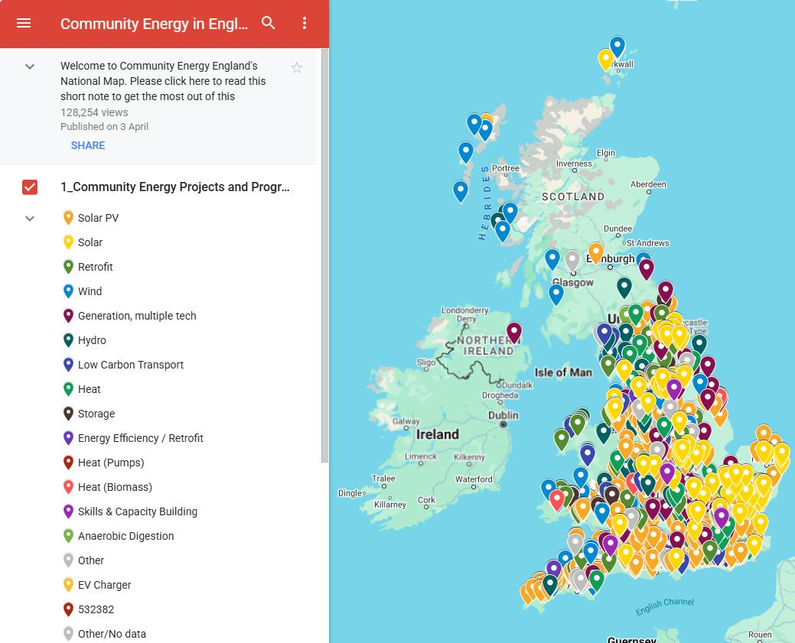
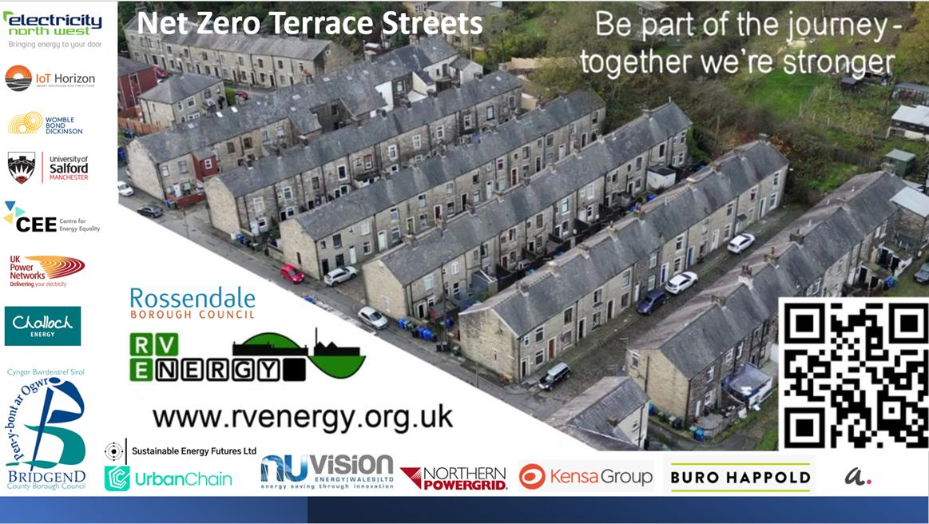
Case Studies
The Westmill Energy Coop in Brighton is the largest in the UK. Together the local community has raised more than £20 million for 5 wind turbines and a ground-mounted solar array. Members receive an average of 8% return on their investment.
National Community Energy Map – lots of examples!
National community energy map | Community Energy England

Slide 8
Funding & advice
Northwest Net Zero Hub: Free strategic & technical support for projects from the earliest stages of feasibility with grant funding & capacity building (Community Energy Lead jack.smith@lancashire.gov.uk / Rhianna.Weston@liverpoolcityregion-ca.gov.uk)
Ashden: Resource rich platform for all community energy groups need, from A to Z (Tools for community groups – Ashden)
Centre for Sustainable Energy: support aimed at tackling the climate emergency and end the suffering caused by cold homes
Community Energy England: Where you will find more than 320 other community energy groups and advice to help develop your ideas
BwDBC Climate Team: We are happy to signpost and help facilitate the process. Please contact us (climatechange@blackburn.gov.uk)
Notes:
Net zero hubs will be helping community energy groups with the Rural Community Energy Fund/GB Energy Community Fund
CSE delivers 3 active funding programmes on behalf of District Network Operators and Gas Distribution Networks
ASHDEN Energy Learning Network - Ashden

Slide 9
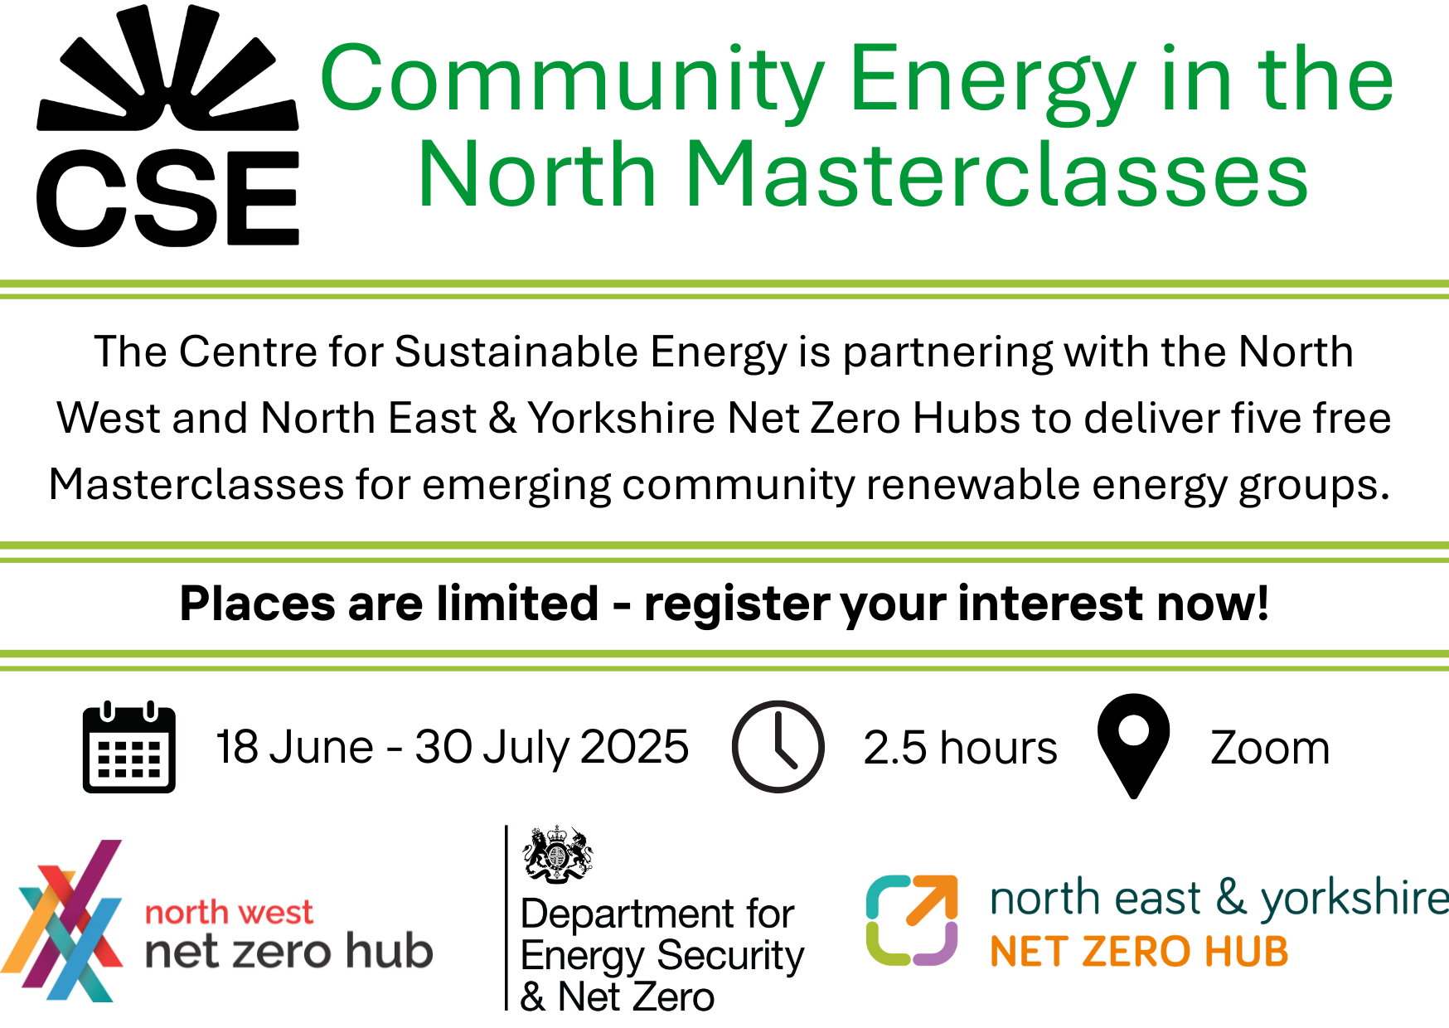
Find out more
Deadline for expressions of interest is Friday 23rd May
Expression of Interest: Community Energy in the North Masterclasses

Slide 10
Thank You
Any questions?

