Slide 1
VCFSE Led Workshop
Vicky Shepherd,
Chair of BwD Community Network; and,
CEO of Age UK Blackburn with Darwen
Garth Hodgkinson, CEO – Community CVS
Community CVS provide secretariat support to the Community Network
02nd April 2025
Notes:
Vicky

Slide 2
Contents
An Overview
What is the BwD VCFSE Sector?
What is the Community Network?
What is the 6P VCFSE Strategy?
Questions about cross sector collaborations
Notes:
Vicky

Slide 3
An Overview: 3 interconnected sectors
Public Economy or the Public Sector
Social Economy or Civil Society or VCFSE Sector
Commercial Economy or Private Sector
This is what we are talking about in this workshop
Notes:
Vicky

Slide 4
What is the VCFSE Sector?
Voluntary (@300 in 2025)
300+ registered local charities plus many regional & national charities
Community (300+? – under the radar or microbiome)
Arts groups, recreation & sports clubs, social groups, etc.)
Faith (@110-120 places of worship)
Christianity: 60 churches Hinduism: 1 organisation – no facility
Islam: 45+ mosques Judaism: no local synagogue
Sikhism: 1 Gurdwara Buddhism: 1 organisation: no facility
Other: 10+
Social Enterprises (@275-300 in 2024)
Companies Ltd By Guarantee; Community Interest Companies
Community Benefit Societies, Employee Owned Businesses, etc
TOTAL +1000 VCFSE GROUPS
Any groups that is not part of the State and is not ‘owned’ by private individuals or businesses or distributes profits.
All assets, profits or surpluses need to be reinvested by the organisation for public benefit.
Notes:
Garth

Slide 5
BwD VCFSE Sector Size
Number of VCFSE Groups: +1000 VCFSE Groups
Turnover: at least £100 million per annum
Net Assets: at least £140 million
Employees: at least 2800 people
Volunteers: unknown but in the thousands
Activities Delivered: unknown but in the tens of thousands
People supported: unknown but probably the majority of the population
Community CVS will be leading a state of the sector research across Lancashire and South Cumbria to find out more and hopefully fill in a lot of the blanks – especially for smaller groups and organisations that do not publish accounts.
Notes:
garth

Slide 6
What is the BwD Community Network?
Who is it for?
Open to all VCFSE groups operating in BwD to participate in its activities;
To help public sector and commercial partners to engage with the VCFSE Sector in a co-ordinated way.
What will the network do?
To develop VCFSE Sector collaborations and link them with our public sector and commercial sector partners.
Hold Annual Conference, quarterly network meetings and many thematic networks
Attract grants, charitable trust and Lottery funding to Blackburn with Darwen and lead collaborative action.
What impact do we want to achieve?
Social, economic and environmental well-being for the residents and communities of BwD
Notes:
Vicky

Slide 7
What are our current priorities?
Community Research
Community insight engagement
State of the sector research
Listening and Engagement with our grassroots and seldom heard voices
2) Partnership Working
Getting Community Network representatives on all BwD Partnerships
Developing a Civil Society Covenant for BwD
Lobbying for a Civil Society Board for Lancashire (alongside the Business Board)
3) Community Network Development & Action
Developing people & leadership skills across the VCFSE Sector
Taking forward actions through the 6P framework (more about this later)
Notes:
Vicky

Slide 8
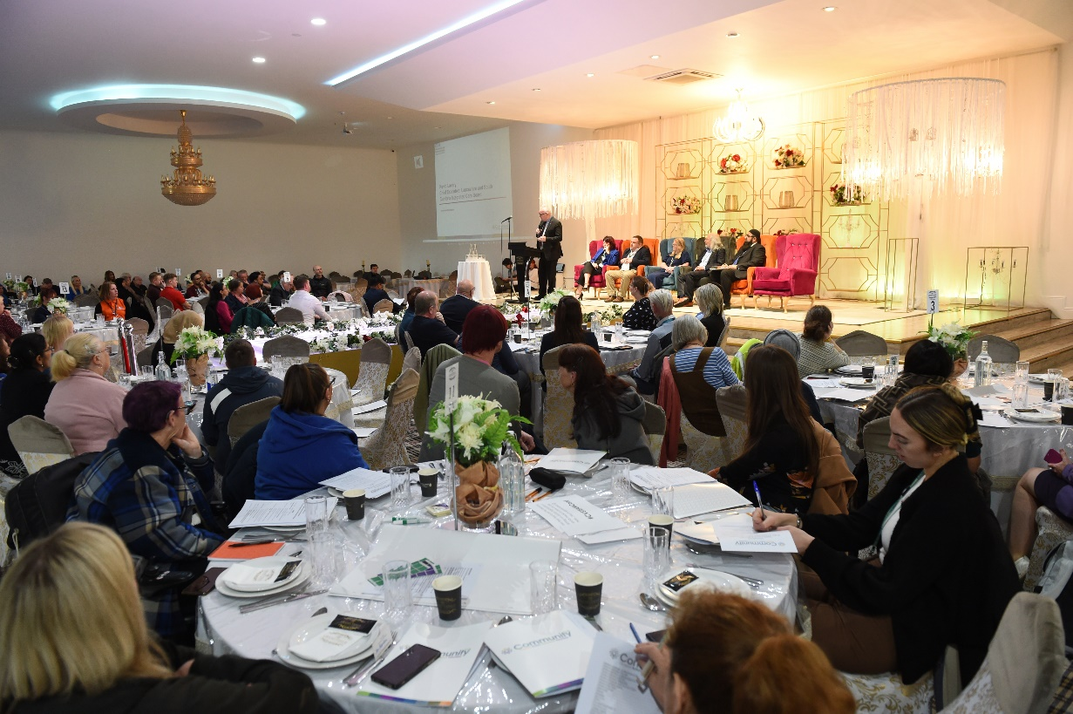
The Start of the Journey: Together Everyone Achieves More Conference, (10th May 23)
Notes:
Vicky
Over 300 people across VCFSE Sector
Key Speakers:
Cllr Phil Riley; Denise Park – Council Missions
Kevin Lavery; Claire Richardson – Health Transformation.
3 Discussions
1: Listening and Discovering what you think the future priorities for the VCFSE Sector should be?
2: Intro the BwD VCFSE Assembly or Alliance idea. Is this something the VCFSE Sector wants to create?
3: What is currently troubling your organisation (that CVS can help you with) and what BIG Ideas do you have to support the VCFSE Sector to develop and grow?
Vote: 97% yes to set up new entity.
Name: 51% BwD Community Network

Slide 9
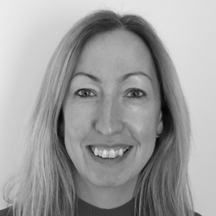
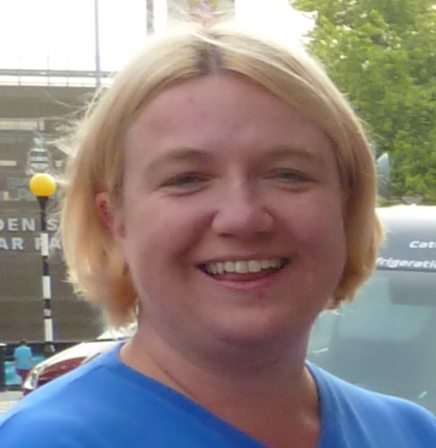
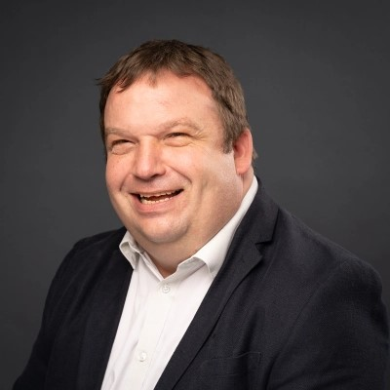
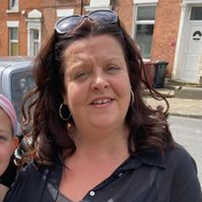
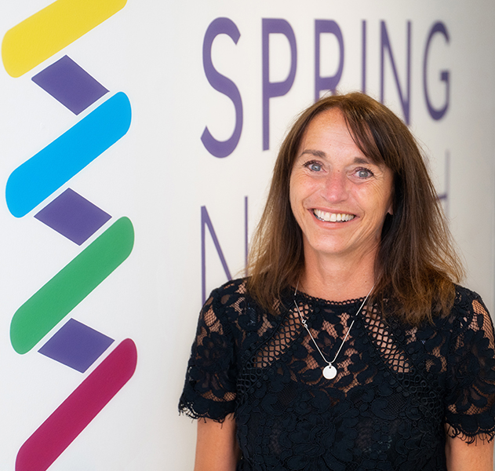
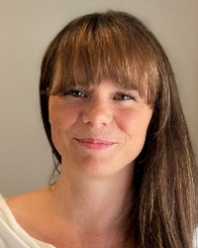
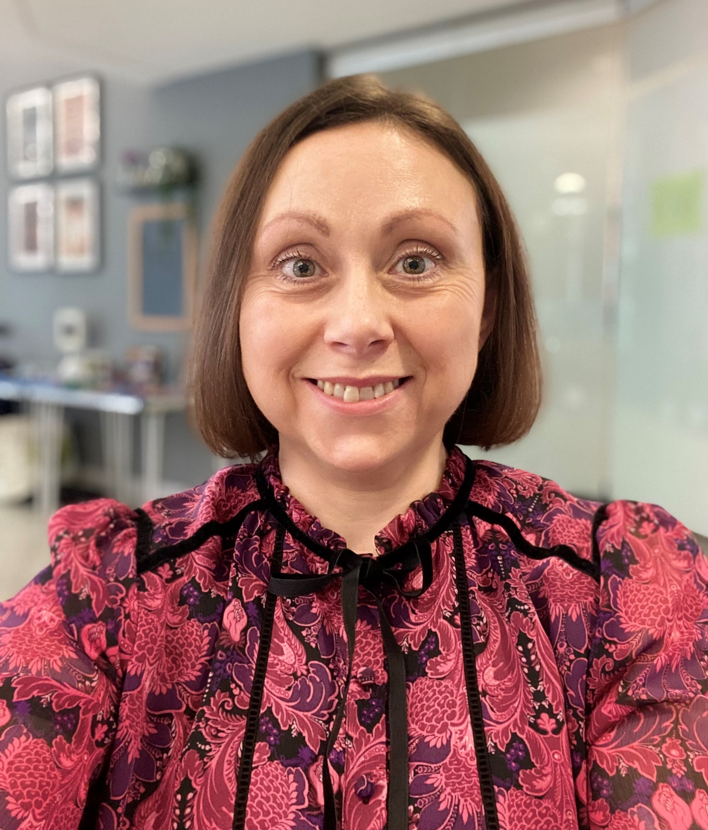
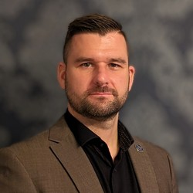
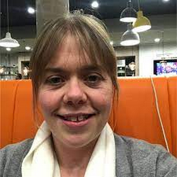
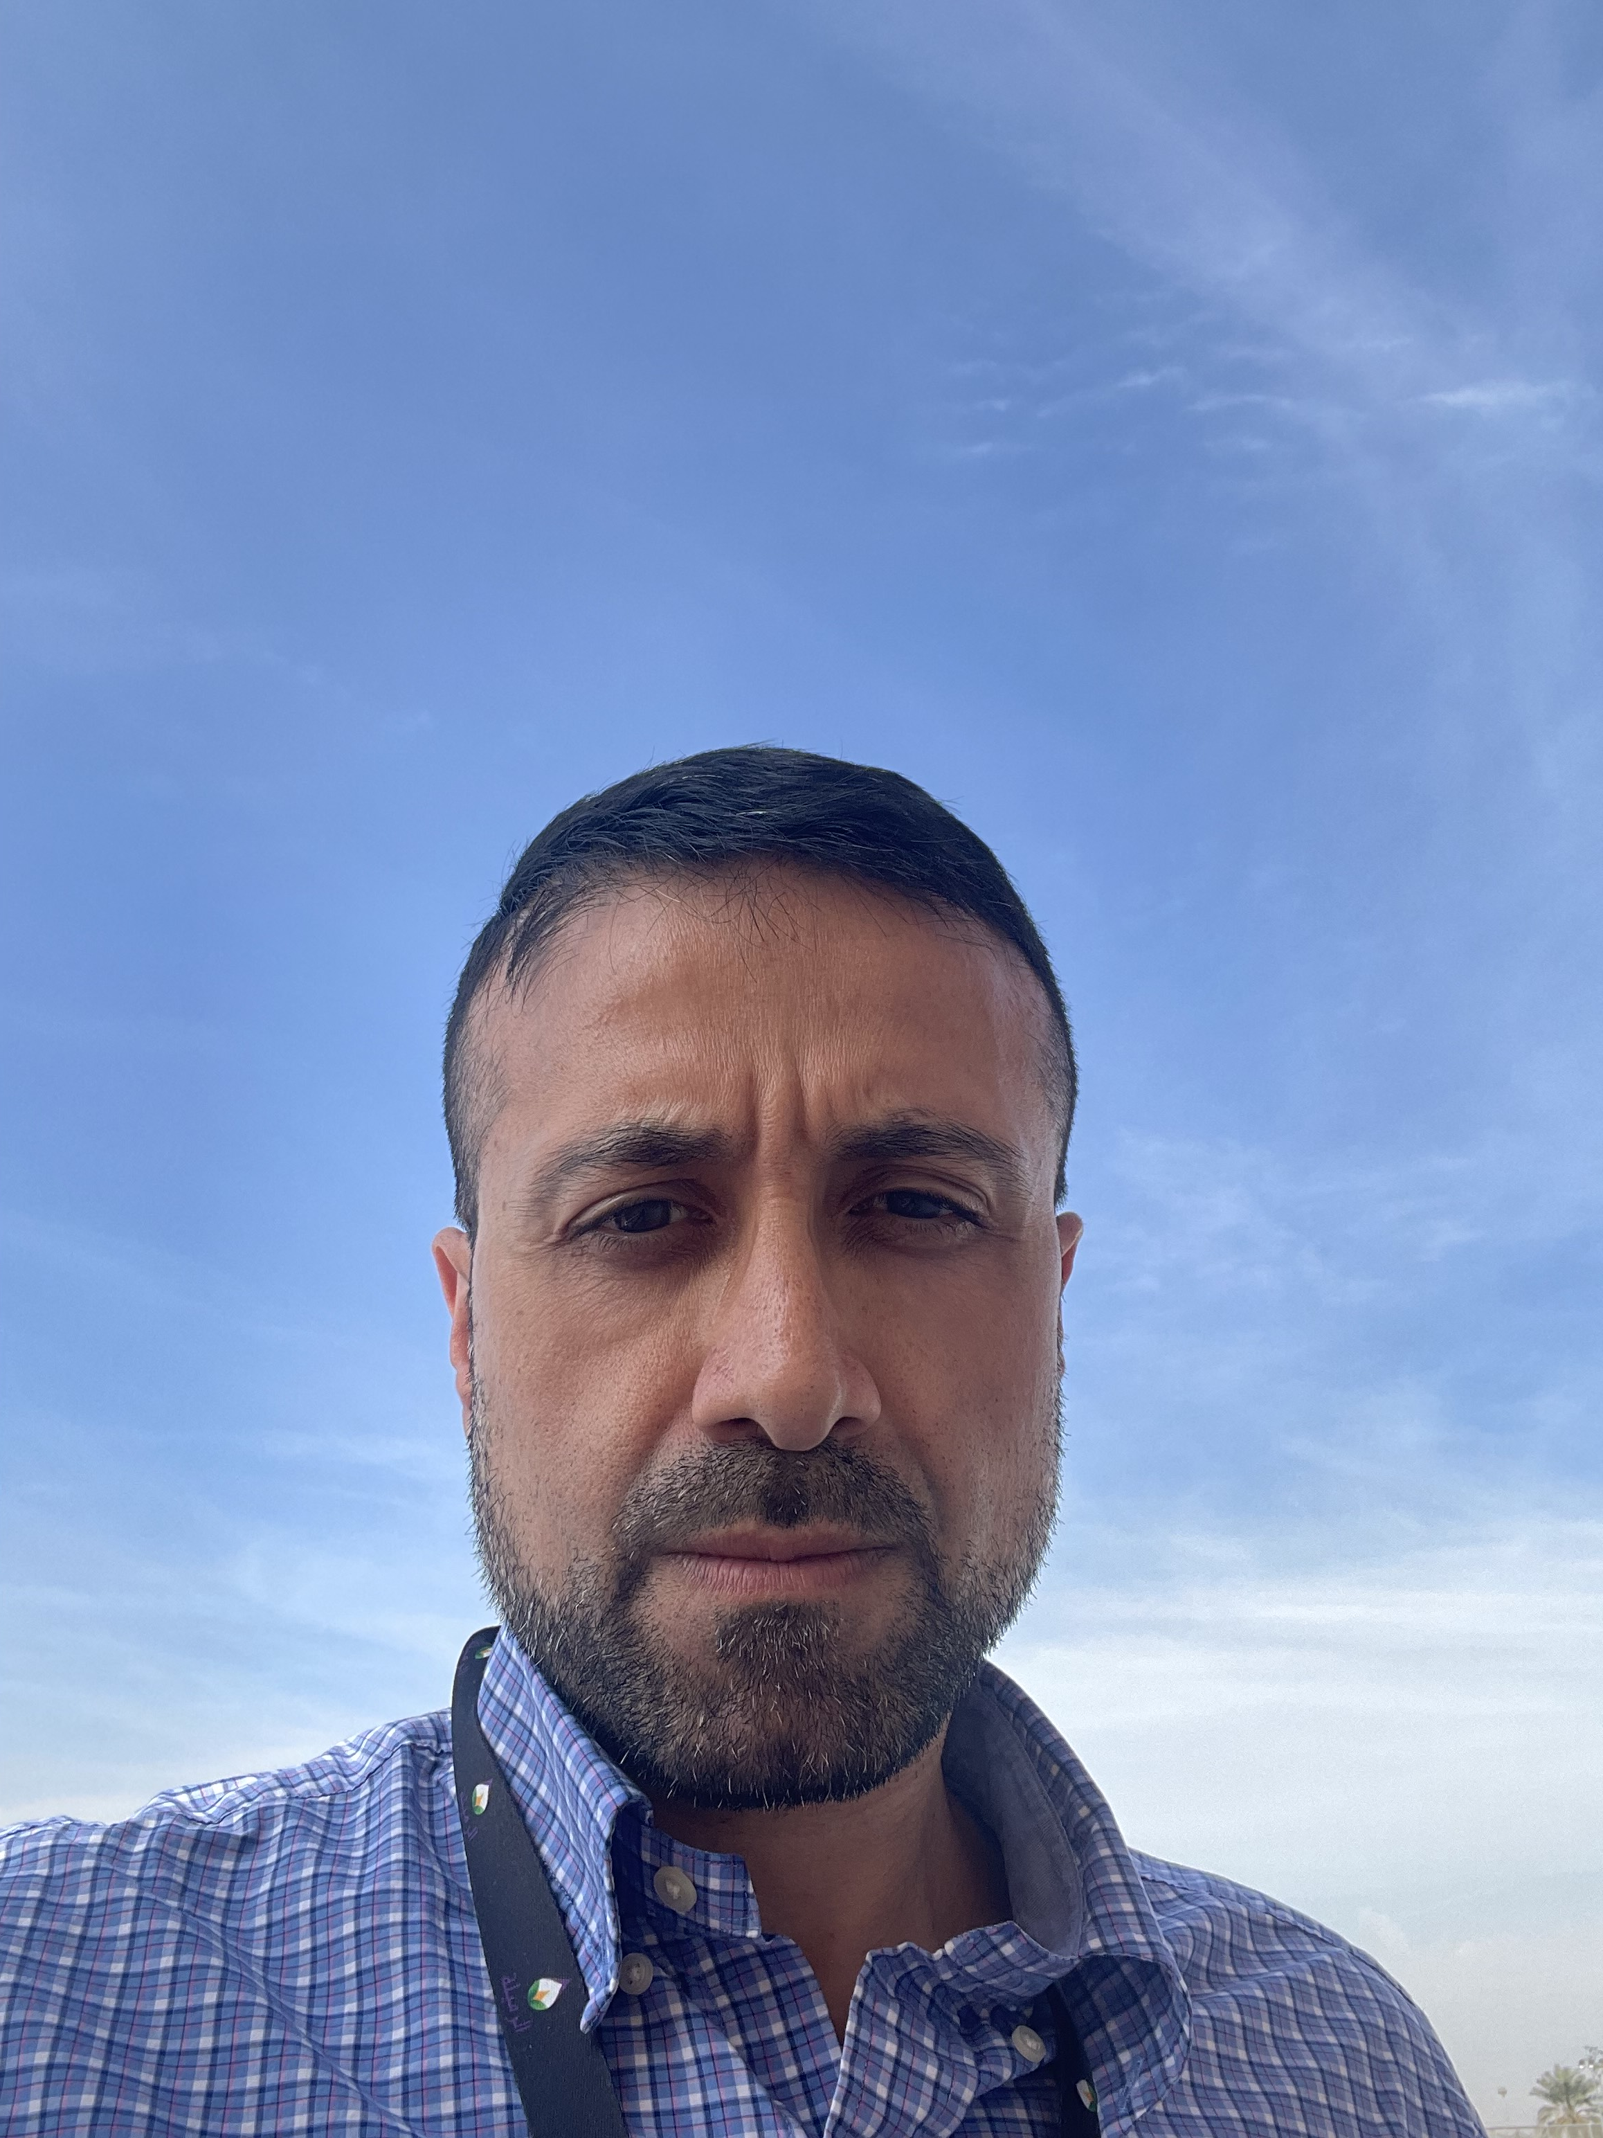
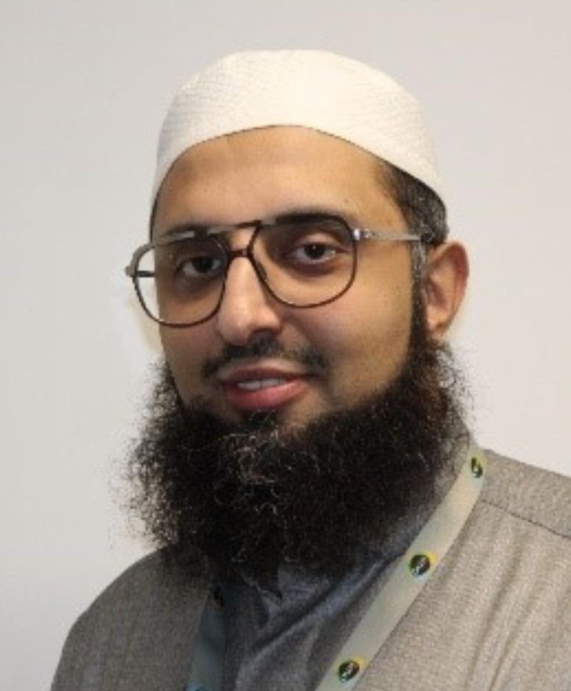
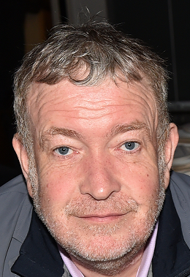
BWD 12 COMMUNITY NETWORK BOARD and the Supporting
Officers
Notes:
Chair: Vicky Shepherd – Age UK Blackburn with Darwen
Vice Chair: Shigufta Khan – WISH Centre / Blackburn and Darwen without Abuse
Board Members
Suzanne Murray, Lancashire Women
Donna Merton, Deaf Village Northwest CIC
Angela Allen, Bags for Strife
Rachel Davies, Newground Together
Hannah Goldthorpe, Friends of Infirmary Area
Aggie Kwiecien, Q Language Services / Polish community
Jawad Bhatti, Blokes United
Rolande Bradshaw, Red Rose Recovery Lancashire and Roots Community
Mohammed Tayyab Sidat MBE, IMO
James Hadleigh, Care Network
Supporting Officers
Garth Hodgkinson – Community CVS; Donna Talbot – Community CVS
Richard Brown – BwD Borough Council; Philippa Cross - NHS

Slide 10
The 6P Conference (04th June 2024) All presentations and notes are on: www.communitycvs.org.uk/action/bwd-community-network/
Notes:
Vicky
The Conference helped to establish the priorities for the 6P VCFSE Strategy.
Key speakers:
Cllr Damian Talbot talked about how health permeates across all the Ps and the important contribution the VCFSE Sector makes towards the health and well-being of our communities.
Martin Kelly talked about the Councils achievements relating to Prosperity and the plans for a Combined Authority.
Garth Hogkinson talked about the 6P VCFSE Strategic Framework and how the VCFSE Sector makes significant contributions across all the Ps.

Slide 11
What is the 6P VCFSE Strategy ?
Social, Economic and Environmental Well-Being
People
Place
Participation
Prosperity
Planet
Peace
Notes:
Garth

Slide 12
People
Asylum Seekers, Refugees & Ethnic Minorities
Young People
Carers
People Experiencing Multiple Disadvantage
Disabled People, Physical or Mental Health
Faith Communities
Older People
Men and Women
Learning Disabilities & Autism
Notes:
Garth

Slide 13
Prosperity
More People in Employment
Increasing Enterprise and Entrepreneurship Skills and People setting up in business
Supporting People In Poverty and helping them to move out of poverty
£
Eradicating Poverty and Promoting the Real Living Wage and Better Working Conditions
Growing Civil Society Organisations & the Social Economy with recognition of civil society as a foundational partner to Economic Partnerships
Workforce Development and Skills
Notes:
Garth

Slide 14
Planet
Skill People & Organisations to move towards being net zero
Mobilise Climate Champions
Make BwD a Sustainable Food Place
Developing a Sustainable VCFSE Sector
Protect and Enhance the Natural World
Recycle, Reuse, Repair & the Circular Economy
Notes:
Garth
Climate Stripes – Created by Professor Ed Hawkins from the University of Reading in 2018. They show clearly and vividly how global average temperatures have risen over nearly two centuries. Each stripe represents the average temperature for a single year, relative to the average temperature over the period from 1961 to 2010. Shades of blue indicate cooler-than-average years, while red shows years that were hotter than average. The stark band of deep red stripes on the right-hand side of the graphic shows the rapid heating of our planet in recent decades.

Slide 15
Peace
Community Cohesion, Respect & Diversity
Community Safety
Community Resilience & Security
Eradicating Violence Against Women and Girls
Domestic Abuse
Safeguarding Children & Vulnerable Adults
Notes:
Garth

Slide 16
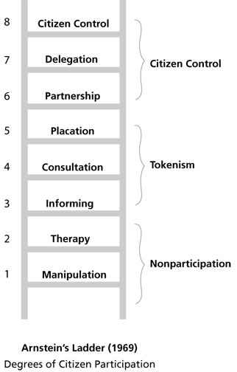
Participation
Co-Production
Widening Participation – Arts, Sport, Learning, etc.
Volunteering and Social Action
Digital Inclusion
Notes:
Garth

Slide 17
Place
Deprived Neighbourhoods
Housing and Homelessness
Our Town Centres and Community Spaces
Our Heritage and Community Assets
Notes:
Garth

Slide 18
How will the 6Ps be delivered?
New VCFSE Networks and Action Groups set up by the Community Network
Alignment of activity with public sector led partnership strategies
Alignment of activity with commercial / private sector activity (corporate social responsibility, etc.)
Championing existing VCFSE Led self managed networks and partnerships
Notes:
Garth

Slide 19
3 Questions for Today
What is your key takeaway from today’s presentation?
How can the Community Network strengthen links with the public and commercial sectors and key partners within those sectors?
What would working with the Community Network members (i.e. voluntary, community, faith and social enterprise sector organisations) look like for you/your organisation?
Notes:
Vicky

