Slide 1
RECYCLING & RESOURCE MANAGEMENT IN BLACKBURN WITH DARWEN

Slide 2
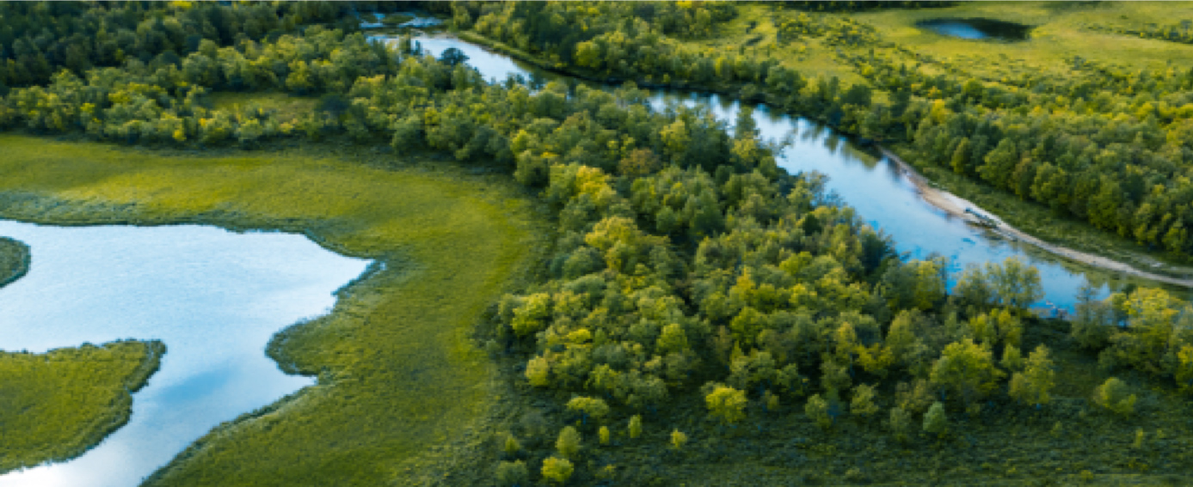
Our Vision – To live in a world where there is no more waste
Our Purpose – Building a sustainable future that doesn’t cost the earth
Our Values – Commitment to the Environment
& Customer Focus
Our Critical Success Factors – Social Value
Strategic Goals – People, Planet
Sustainability Champions – Connecting with our community
About us
Notes:
Strategic Goals = People – Positively impacting our society & Planet – Going beyond net zero carbon , using less and reusing more.
Sustainability Champions = a day to Volunteer for all employees , Open days with Schools, Talks in Schools, Community Donations and fundraisers (Youth Zone, Heart Foundation, Community walks)

Slide 3


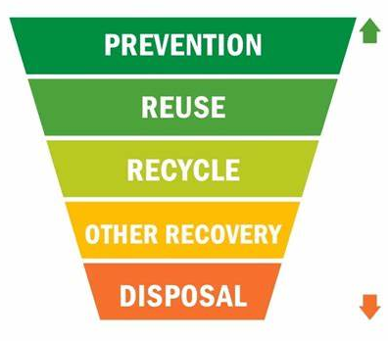
Re-use

Slide 4
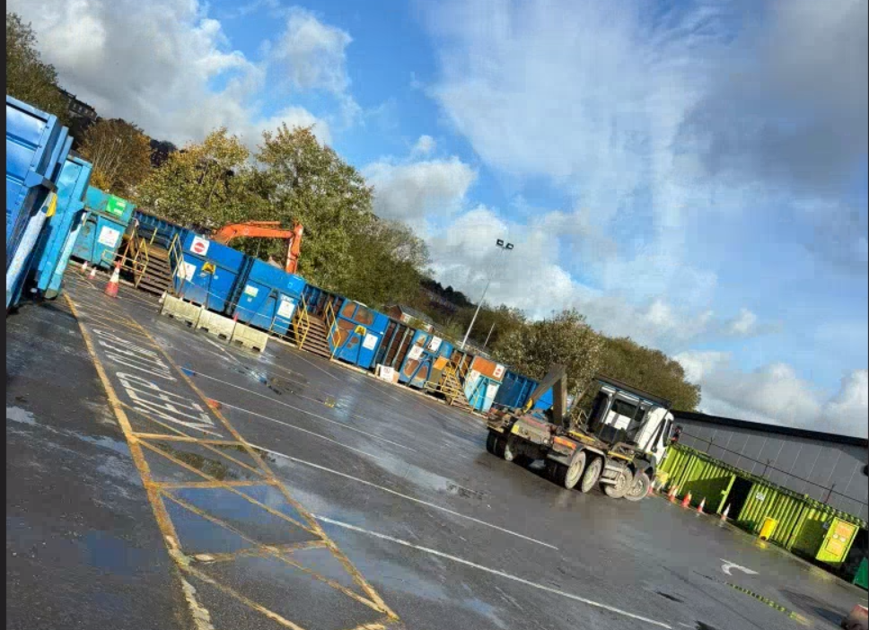
BwD Household Waste Recycling Centres
Blackburn HWRC –
8k t/pa
Darwen HWRC– 3.5k t/pa
Notes:
Big focus to improve our Household Recycling Operations since we started but the project started around September
We want to achieve a minimum 60% Recycling rates and re-use as much as where possible – in line with waste hierarchy (mentioned previously)

Slide 5

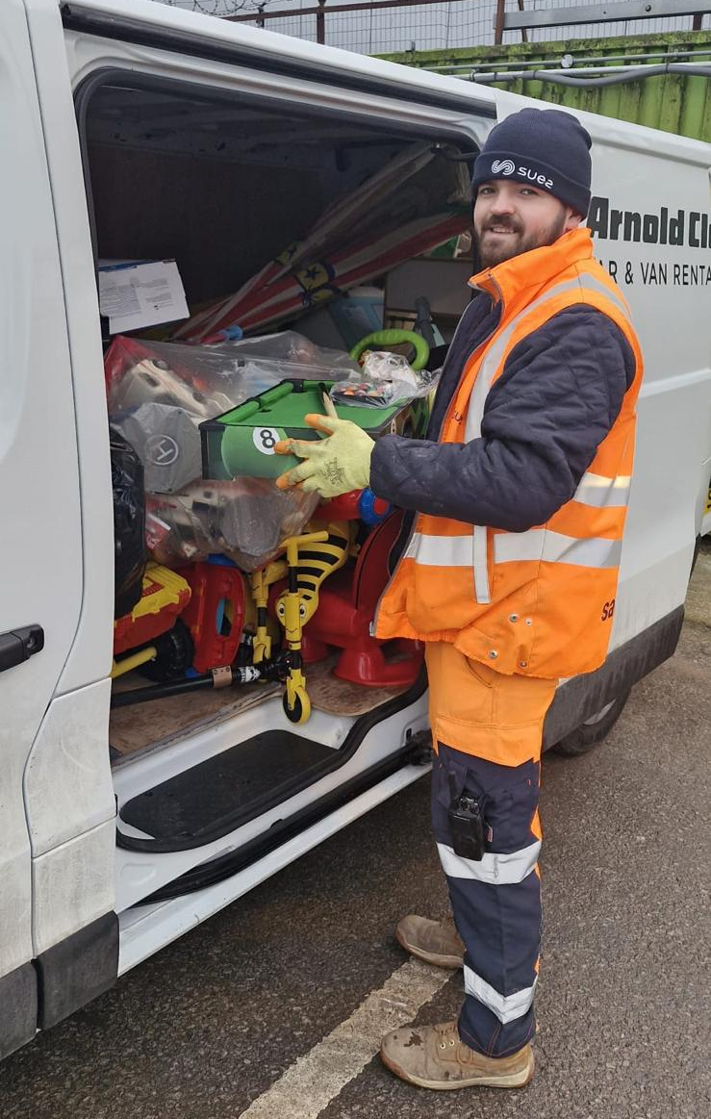
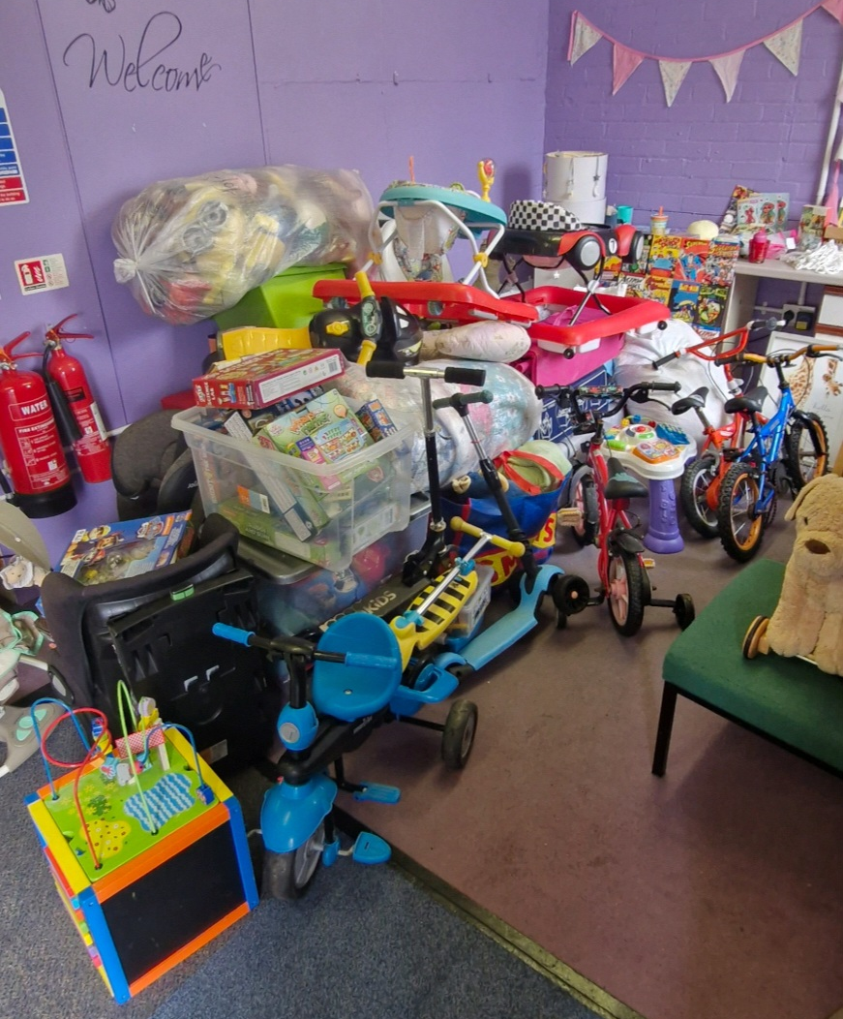

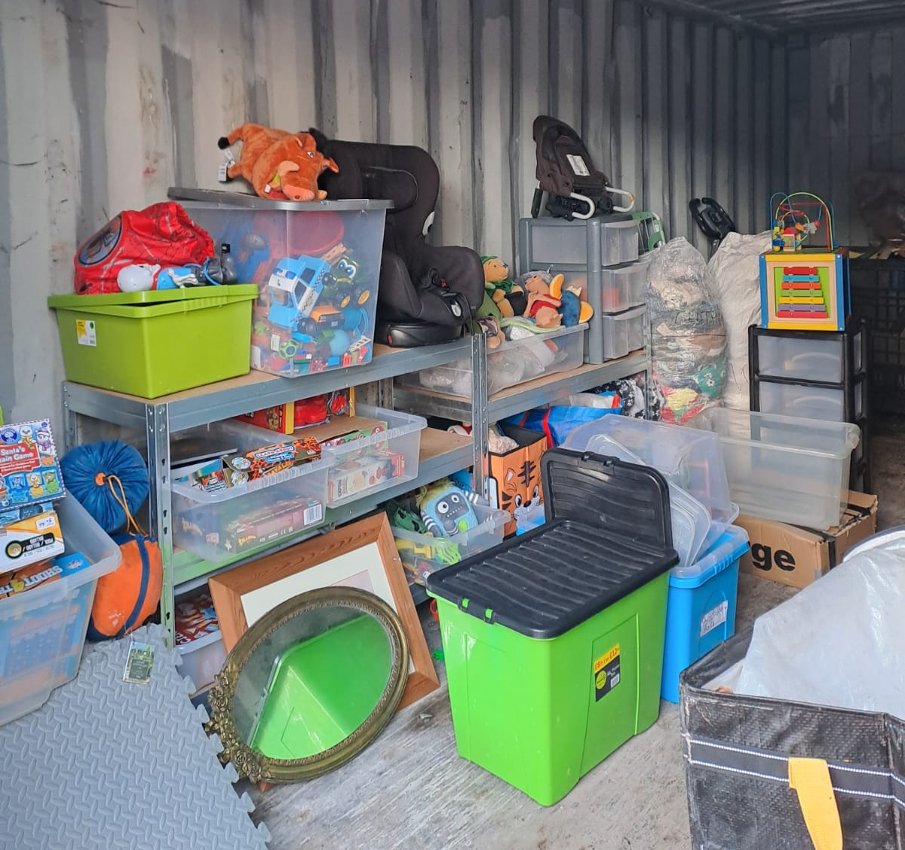
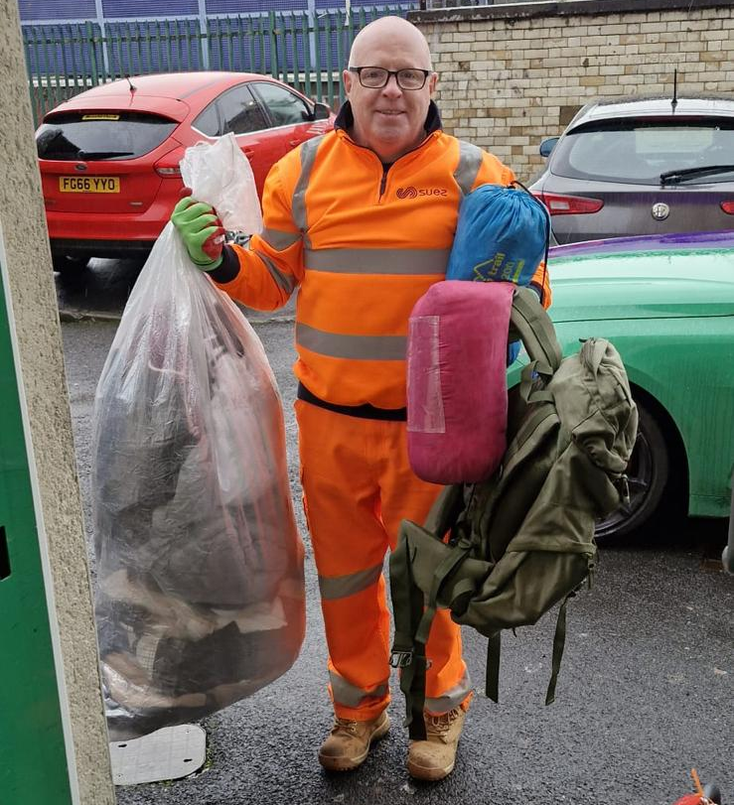

Our partnerships
1000kg Toys/Clothes/Equipment
1500kg of Bikes and Sport Equipment
100kg of clothing and sleep equipment
Notes:
Re-use Schemes have started since December 24 – in 3 months we have diverted from Disposal/Recycling nearly 3tonne of re-useable material via only 3 schemes– a tonne of re-use each month!
In addition,
We have supplied small amounts of gardening equipment to a local school to develop their local environment.
Also pending (contract)
Setting up re-use paint network through community re-paint that will be potentially distributing via another local charity
Have been exploring medical equipment & children's uniform
Supplying gardening equipment to the Corporation Park Supporters Group that have a community garden at corporation park that support volunteers, local scout groups and school
Team repair to local schools that deliver a programme to enable teachers to deliver hands on sessions around refurbishment and repairing.

Slide 6
Any questions?
ideas on how we can further support our community?
Thank you
Notes:
If successful – hoping to hear in the next couple of weeks.

