Slide 1
BwD Community Network Quarterly Meeting Tuesday 8th October 2024

Slide 2
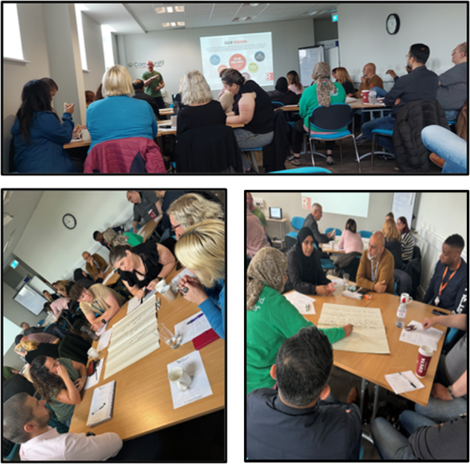
Great attendance at our Quarterly Blackburn with Darwen Community Network Meeting: Co-Production with a wonderful thirty-one attendees.

Slide 3
AGENDA
1.Welcome
2. Introductions
3.Update from the 6P's conference
4. Updates on Health
5.Co-production – How to successfully work together on an equal basis to create a service or come to a decision which works for everyone – Roland Bradshaw BwD CN Board Member
6. Any other Business
7.Networking

Slide 4
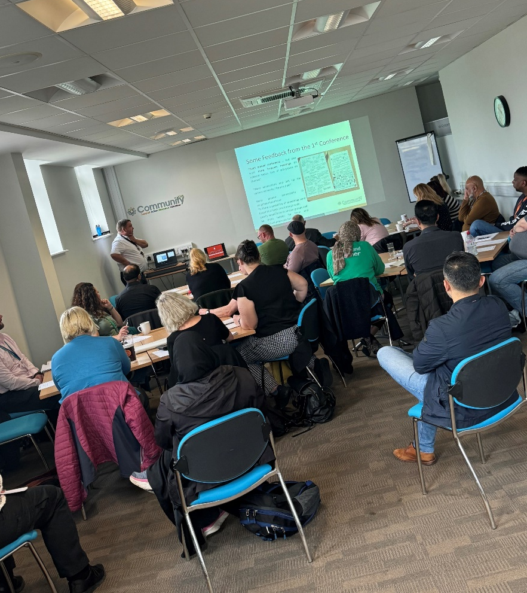
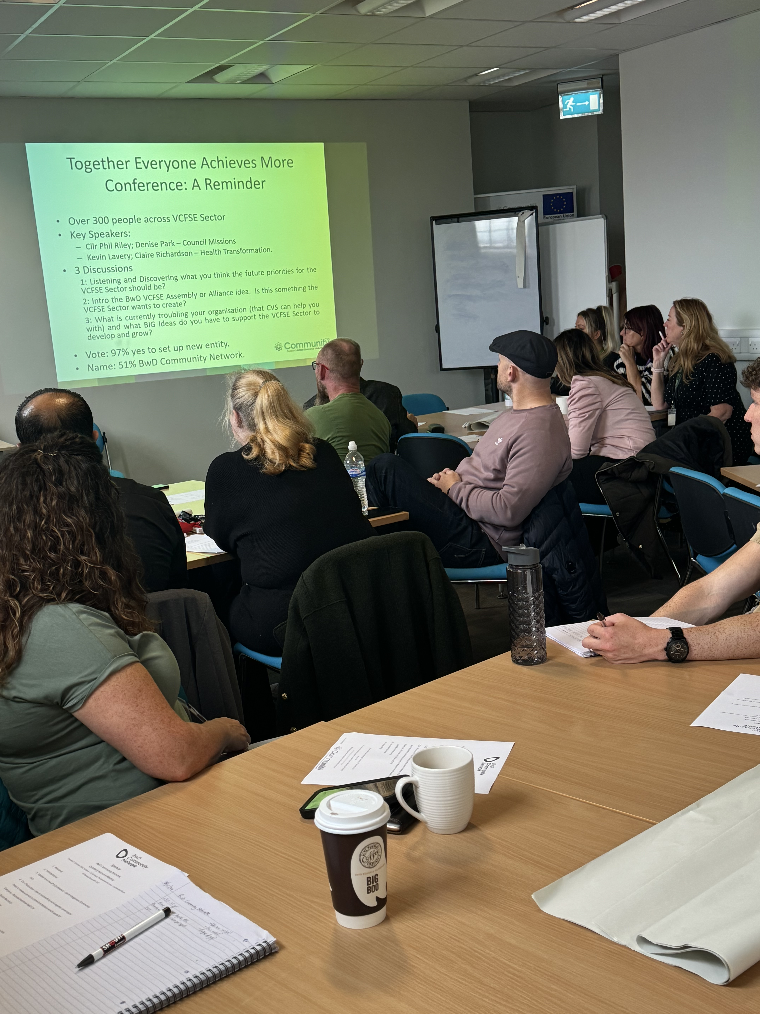
Update from the 6p’s conference – Garth Hodgkinson

Slide 5
BwD Place Based Partnership
Winter Pressures
Focus on winter, working with lots of different local people – helping them to keep well and stay away from A&E
Heavy Focus on Health & Care Partners, better communications and looking at how we all can work better
Engagement and co-production with residents
Look at how the public sector respond better to local people
Age UK working on falls prevention in Darwen (small grants available for local groups wanting to get involved)
Roots, Thomas and 180 project working in Blackburn Central Ward
NHS have changed their way of funding Winter projects and are heavily relying on VCSFE Sector to run projects and spread the NHS Winter messages

Slide 6
Population Health
Funding Currently on hold – funds for working with the most deprived wards in BwD – 11 out of the 18 wards fall under the core20 (the most deprived 20% of the national population as identified by the index of multiple deprivation
Lots of discussions happening, looking at resources etc for Blackburn Central Ward and Darwen East
BwD BC need to discuss with VCSFE sector how we can all work together more productively, efficiently and cost effective so when funds are available – We will be ready and in a good place when the cash comes.

Slide 7
Volunteering for Health
Community CVS, Cumbria CVS, LACVS, Spring North, Volunteer Centre BwF and Lancashire Teaching Hospitals Charity have been successful in winning this funding
We were only one of the fifteen successful applicants across the country
The funding is there to look at volunteering infrastructure – training packages, Quality Standards etc.

Slide 8
Work Well Vanguard
Covers 7 areas across Lancashire - ICB awarded £4.5 million in total
BwD leading Council – guaranteed a share as one of the populations with the worst health
Work Well is an early-intervention work and health support and assessment service which aims to provide holistic support to address health related barriers to employment.
The programme will provide lower-level intervention for people at risk of falling out of work or for those who have had to stop working because of a health condition.
Within the programme there is a strong emphasis on providing a single, joined-up view and gateway into services that are available locally to meet the specific needs of individuals.
November the project starts – Deliver a holistic work and health service with a single joined up view and pathway into locally available support services.
Join up the work and health landscape at a local level, bringing together various work and health initiatives and assets together under one coherent strategy – not sure how that looks at the moment
The Project will run for 18 months ends in 2026

Slide 9
Lancashire VSCFE Alliance
Exploring Mapping /Survey Sector across Lancashire and South Cumbria
LSC Integrated Care Board - Vision of all data NHS, Local Authority, VSCFE to be shared more effectively in a safe and secure way.
LSC VCFSE Alliance :: Home

Slide 10
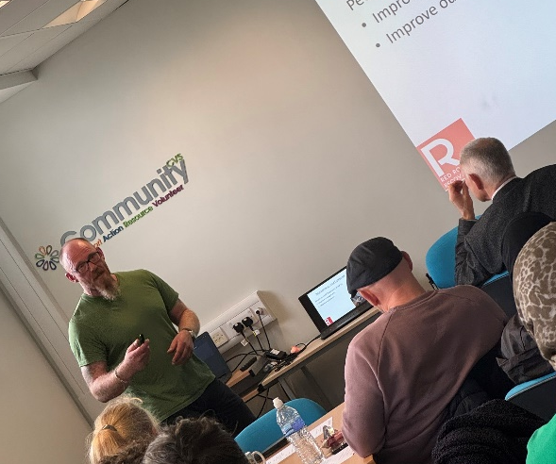
Workshop
Co-Production – How to successfully work together on an equal basis to create a service or come to a decision which works for everyone – Rolonde Bradshaw (Roots Community)

Slide 11
Group 1

Slide 12
Group 2

Slide 13
Group 3

Slide 14
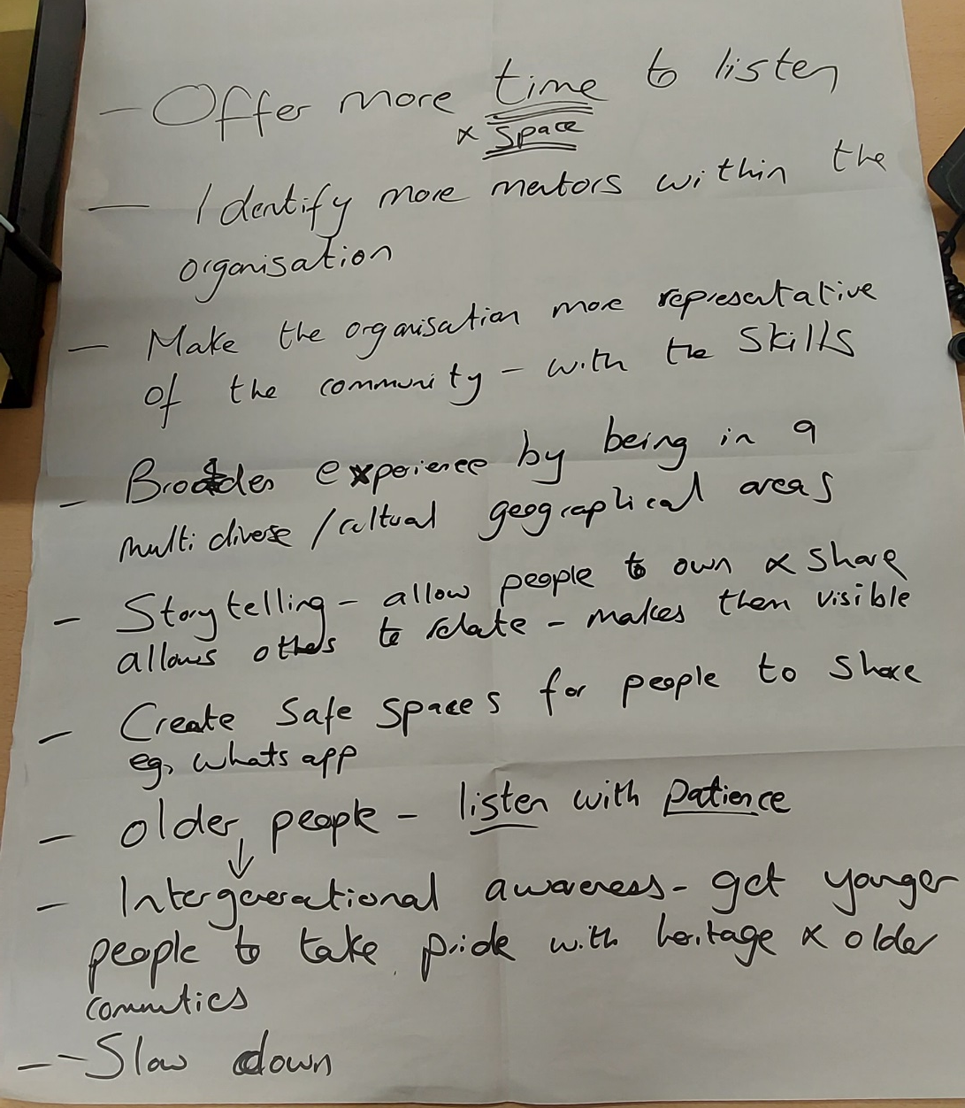
Group 4

Slide 15
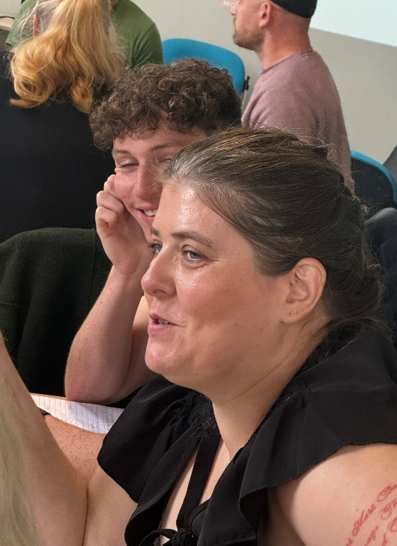
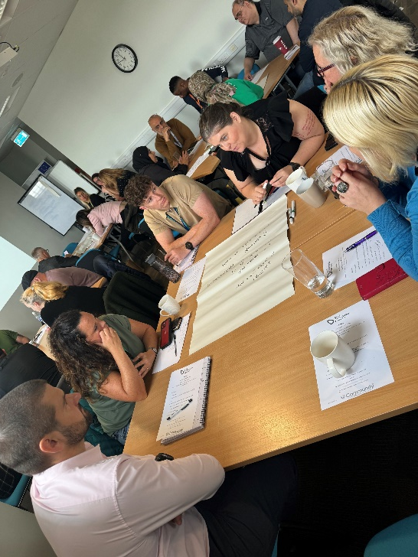
Feedback :
“Great atmosphere, learnt lots of really good tips ”
“Always great to Network”

Slide 16
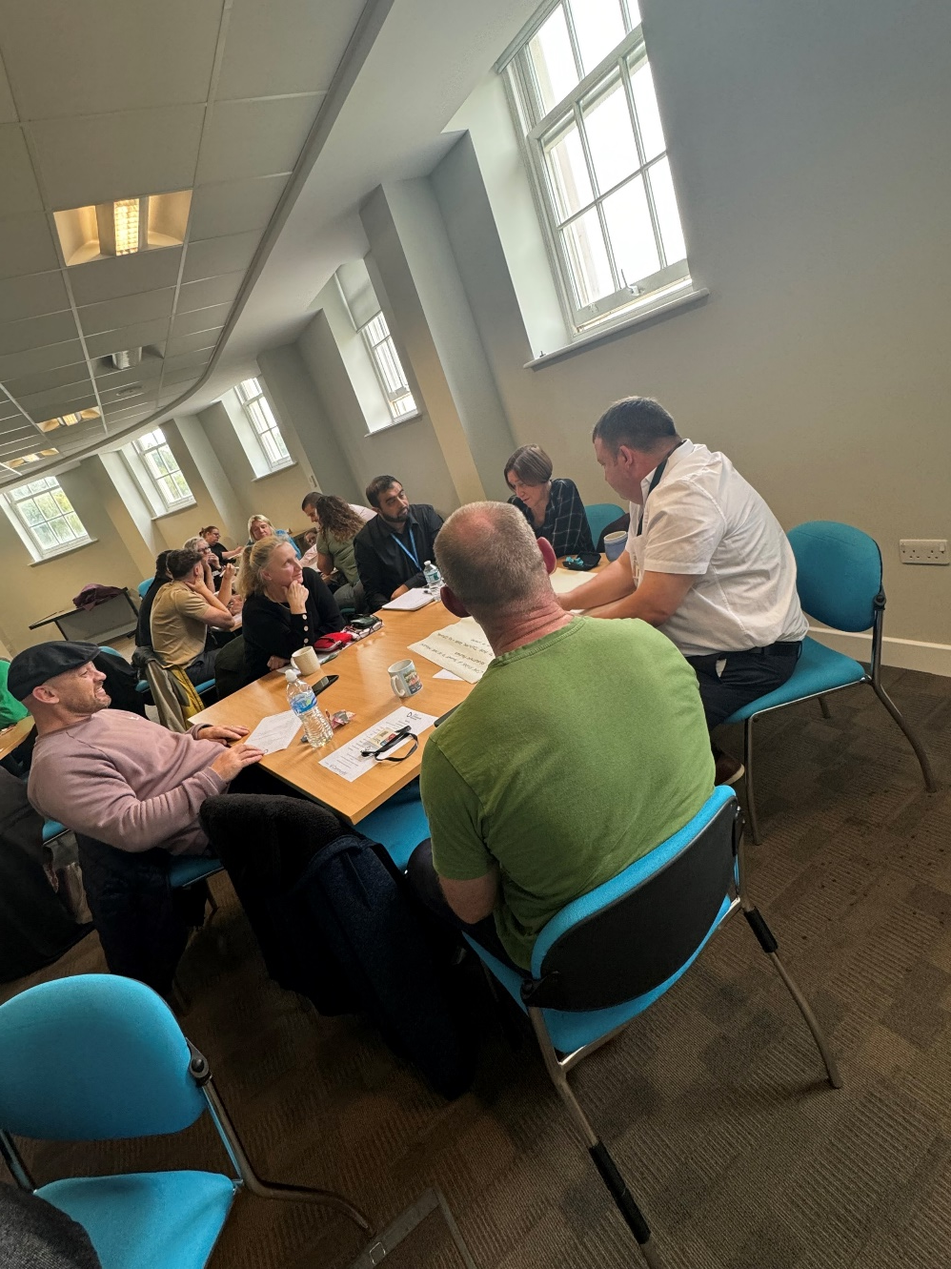
Feedback
“Really enjoyed the interactive nature of the meeting”
“The meeting did meet my expectations – a very informative event”

Slide 17
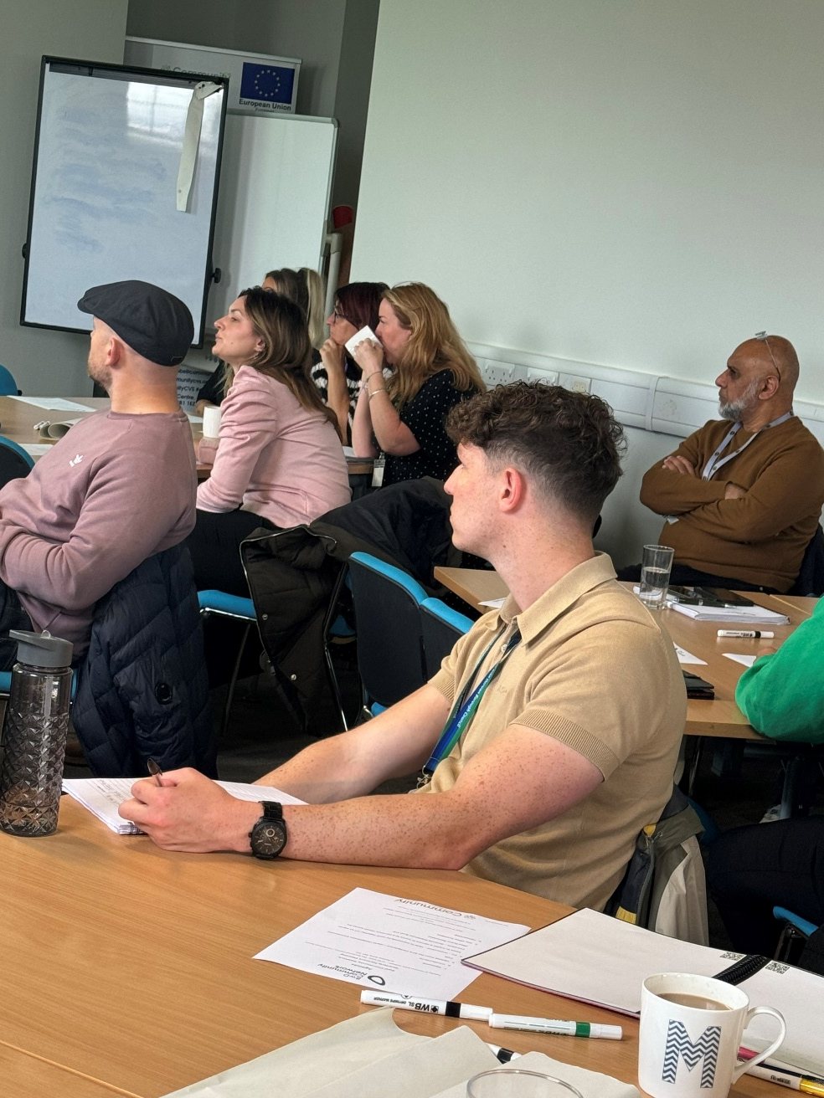
Feedback :
“Great atmosphere, learnt lots of really good tips ”
“Always great to Network”

Slide 18
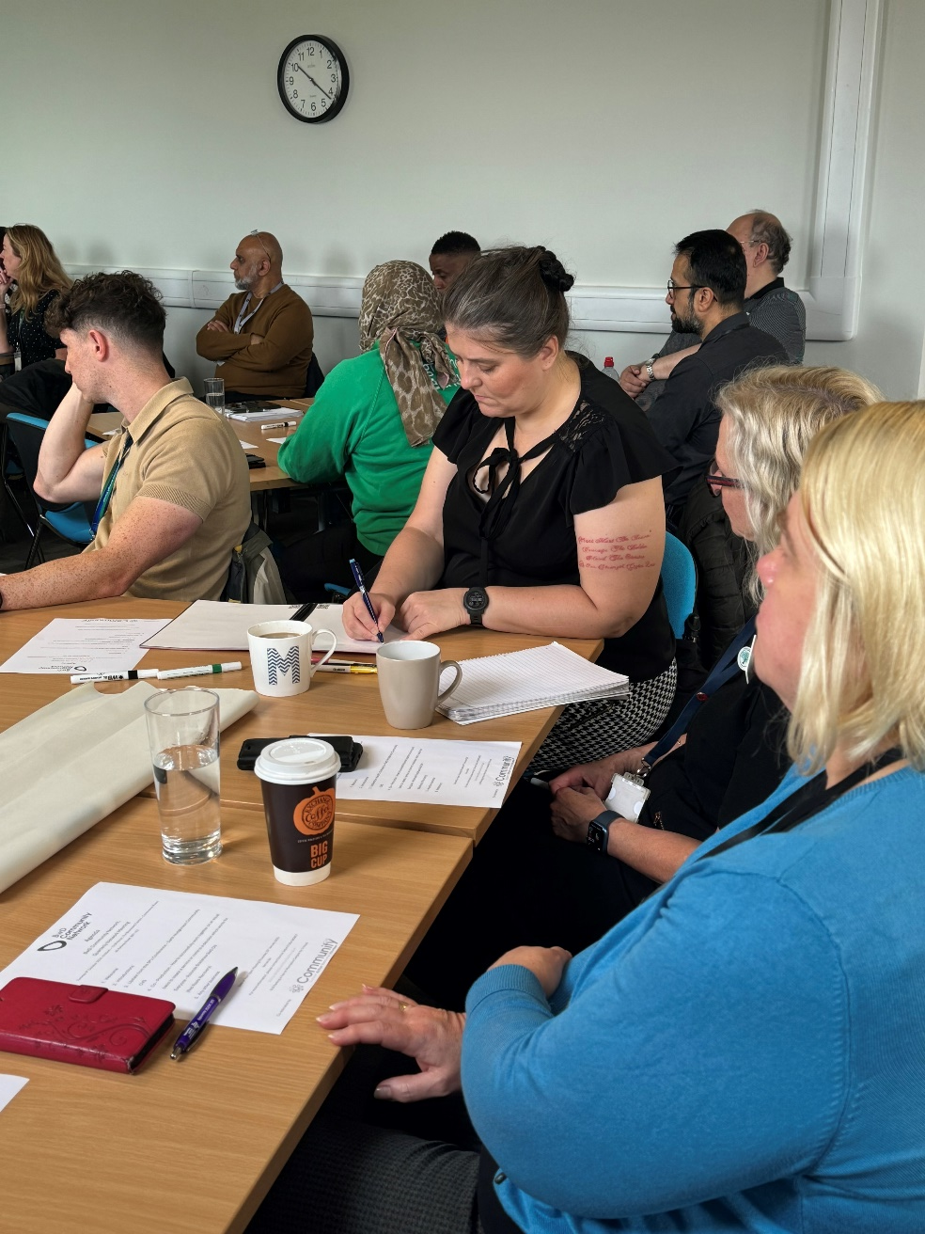
Feedback
“Good chance to meet members of the community at work on the ground”

Slide 19
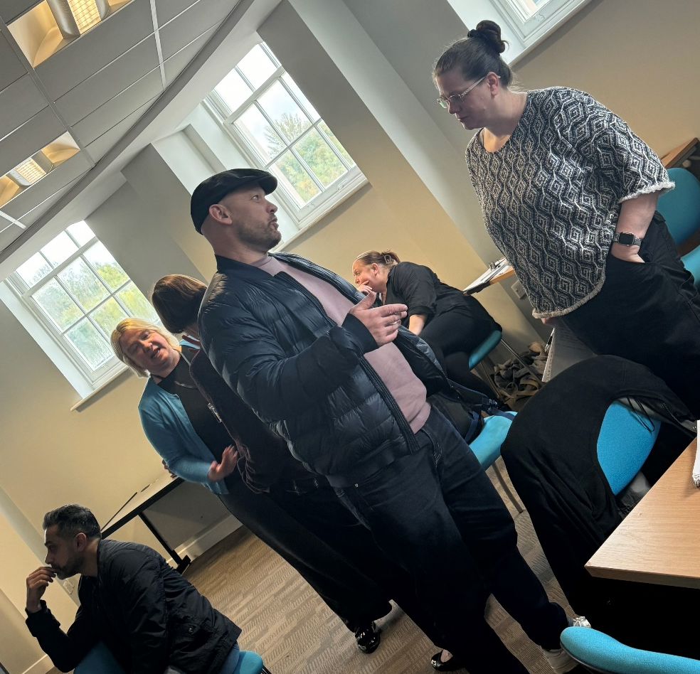
Feedback:
“Great Networking opportunity – also learned about what is happening in the Blackburn with Darwen area and how we can potentially support initiatives/work collaboratively.”

Slide 20
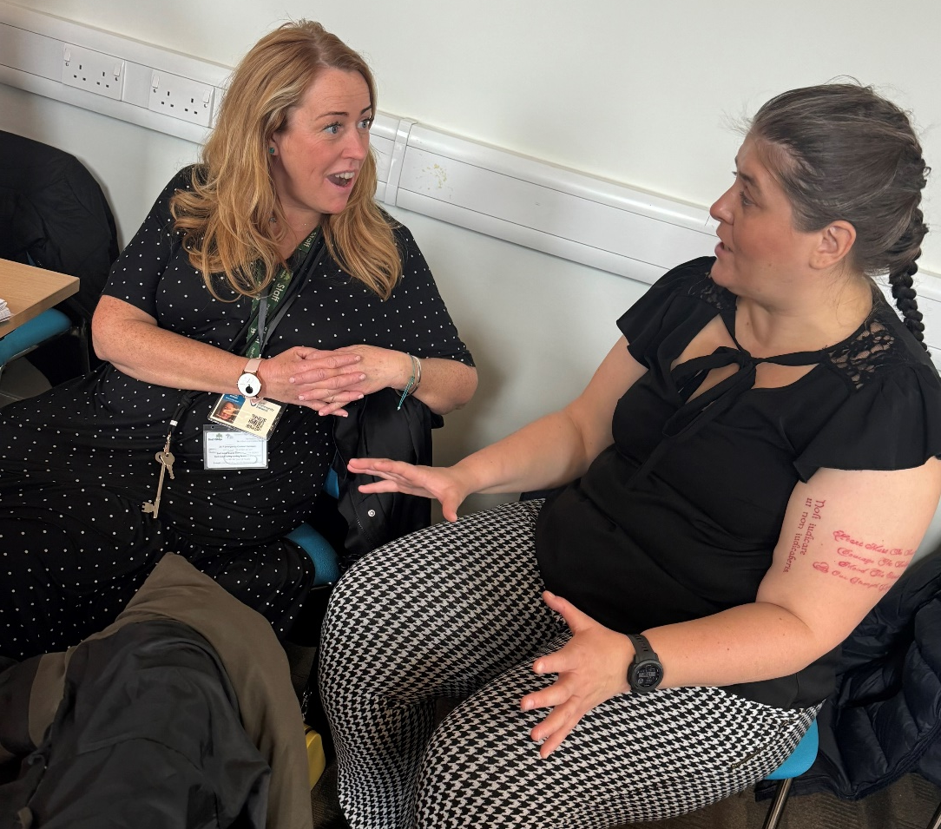
Feedback
“I Look forward to the next meeting, really enjoyed today, made some really good contacts”

