Slide 1
Community acupuncture uk cic
John Livesey BSc, PhD, M.BAcC
COMMUNITY ACUPUNCTURE UK CIC

Slide 2
Agenda
About me
Introducing Community Acupuncture UK
About acupuncture
What can acupuncture treat?
Is acupuncture safe?
The community multibed model
Next steps
Questions

Slide 3
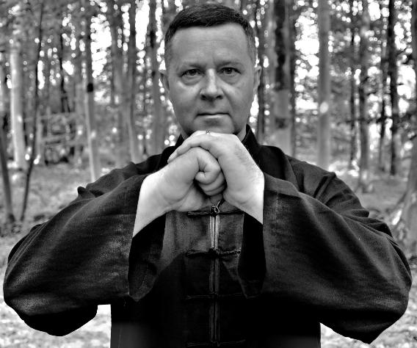
About me
John Livesey.
Born and brought up in Blackburn.
Went to Shadsworth High School and Blackburn College.
Lives and works locally.
Tai Chi and Qi Gong practitioner and teacher.
Acupuncturist.
Qualified with a 1st Class Hours degree in Acupuncture from the renowned Northern College of Acupuncture.
COMMUNITY ACUPUNCTURE UK CIC
3

Slide 4
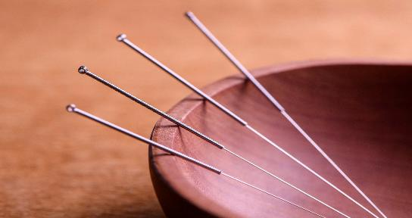
Introducing community acupuncture uk CIC
A Community Interest Company.
Limited by guarantee - Not-for-profit.
Based in Blackburn with Darwen.
Providing acupuncture and associated treatments.
Serves local people with health conditions on low incomes.

Slide 5
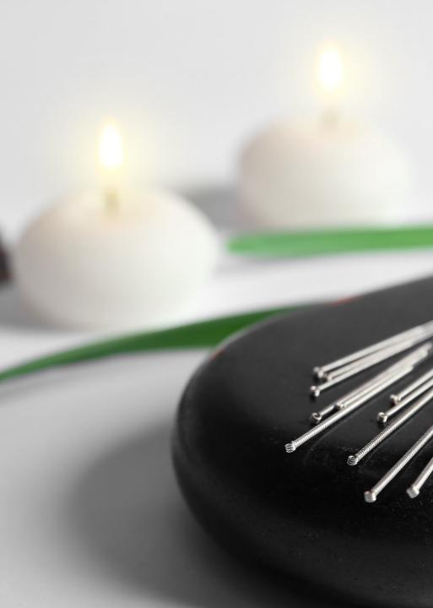
About acupuncture
A system of healing developed in China over 3,000 years ago.
Works with the body’s Qi (internal energy), which flows through the body in a network of channels.
Involves the insertion of fine needles into points on the channels.
Acupuncture points have specific healing effects.
Encourages the body’s natural healing capacity.
Ancillary treatments including electro-acupuncture, auricular (ear) acupuncture, bodywork, moxibustion, gua sha, cupping and Qi-Gong.

Slide 6
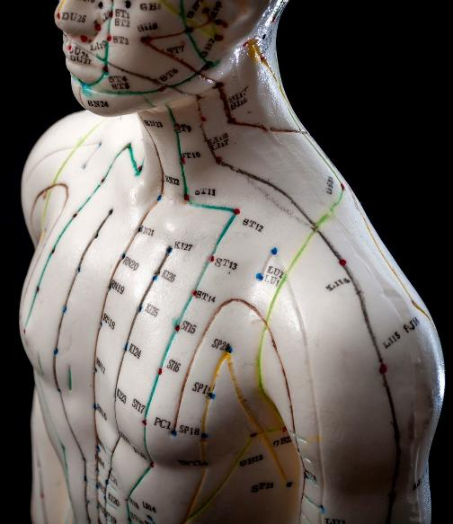
What can acupuncture treat?
Two Perspectives:
1. Traditional Chinese Medicine
Acupuncture is used to treat almost any health condition.
2. Modern Clinical Research
There is a growing body of high-quality clinical research demonstrating acupuncture is effective in treating a wide range of health conditions
COMMUNITY ACUPUNCTURE UK CIC

Slide 7
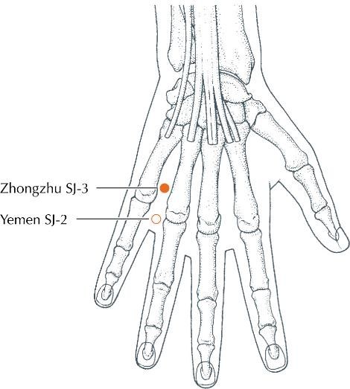
What can acupuncture treat?
Strong evidence of positive effect
Allergic rhinitis (hay fever).
Osteoarthritis
Knee pain
Migraine
Headaches
Chronic low back pain
Nausea and vomiting
Post-operative pain
COMMUNITY ACUPUNCTURE UK CIC

Slide 8
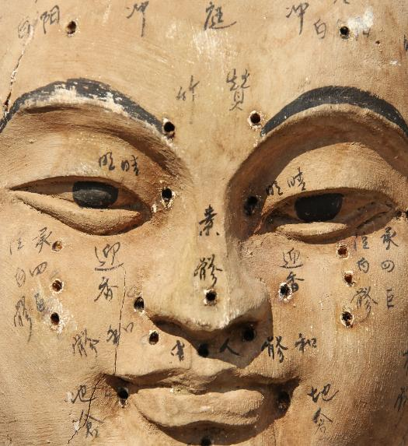
What can acupuncture treat?
Evidence of positive effect
Acute low back pain
Sciatica
Neck pain
Elbow pain
Temporomandibular pain
Plantar fasciitis
Cancer pain
Anxiety
Depression
PTSD
Substance & alcohol abuse
Hypertension
Fatigue
Menopausal hot flushes
Insomnia
Asthma
Obesity
IBS
Constipation
Dry eyes
Breech presentation
Stroke rehabilitation
COMMUNITY ACUPUNCTURE UK CIC

Slide 9
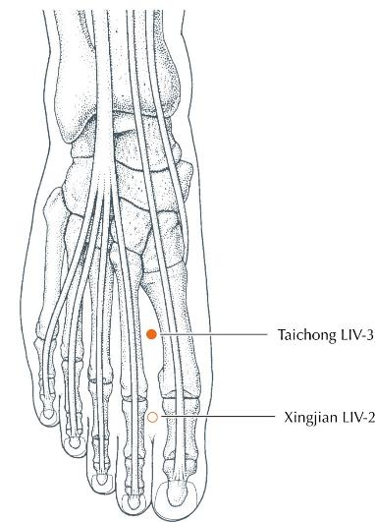
What can acupuncture treat?
A word about pain
NICE guidance for the treatment of chronic pain conditions recommends GPs offer a course of acupuncture before prescribing medication.
Complementing mainstream treatments
Cancer treatment
Reducing the side effects of drug treatment, e.g. hot flushes, nausea.
For cancer related and post-operative pain.
Treating anxiety and depression.
IVF
Many IVF clinics recommend acupuncture as a complementary treatment.
COMMUNITY ACUPUNCTURE UK CIC

Slide 10
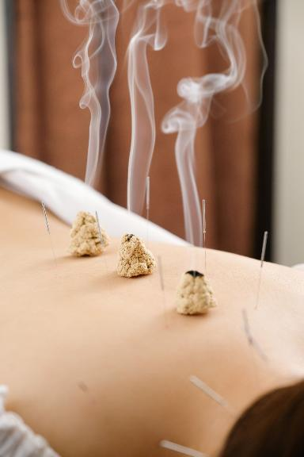
IS ACUPUNCTURE SAFE?
Yes – By a properly trained acupuncturist
York Acupuncture Safety Study published in the BMJ in 2001:
34,407 acupuncture treatments.
No serious side effects.
43 instances of minor side effects, e.g. bruising, local pain.
Very safe in comparison to prescribed medications.
Community Acupuncture UK CIC acupuncturists:
Have a minimum of 3 years training at degree level.
Are members of the British Acupuncture Council (BAcC), the professional association for acupuncturists in the UK.
Work to BAcC codes of safety and professional practice.
Fully insured.
DBS checked.
First aid qualified.
COMMUNITY ACUPUNCTURE UK CIC

Slide 11
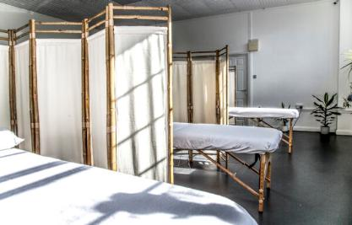
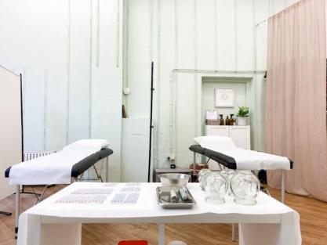
Community acupuncture: the multibed model
A private acupuncture appointment typically costs £45 - £55.
Unaffordable for those on low incomes.
To make acupuncture more affordable to more people in our community, we need to adopt a ‘community multi-bed model’.
A community multibed setting increases the number of patients an acupuncturist can treat. This brings down costs and make treatments more affordable.
A tried and tested model:
There are multi-bed clinics in Manchester and Lancaster.
Association of Community and Multibed Acupuncture Clinics (ACMAC).
COMMUNITY ACUPUNCTURE UK CIC

Slide 12
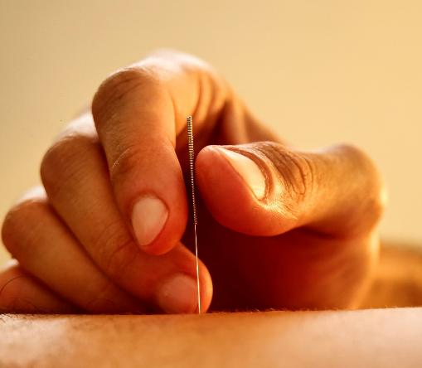
Next steps for community acupuncture uk CIC
Finalise governance.
Obtain and register premises.
Secure grant funding.
Raise awareness.
Our first Blackburn with Darwen Clinic opens January 2025.
Working towards one clinic in Blackburn and one in Darwen.

Slide 13
QUESTIONS?

Slide 14
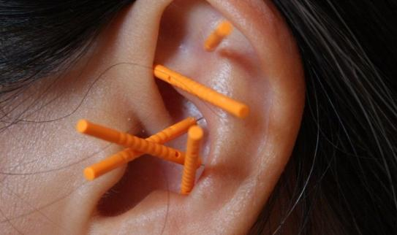
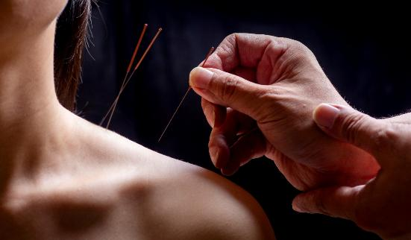
THANK YOU FOR LISTENING
Contact us To find out more about how acupuncture can help you or the people you support.
John Livesey| john@appliedacupuncture.co.uk

