Slide 1
Introducing the BwD Community Network and the 6Ps
Garth Hodgkinson, CEO, CVS
04th June 2024

Slide 2
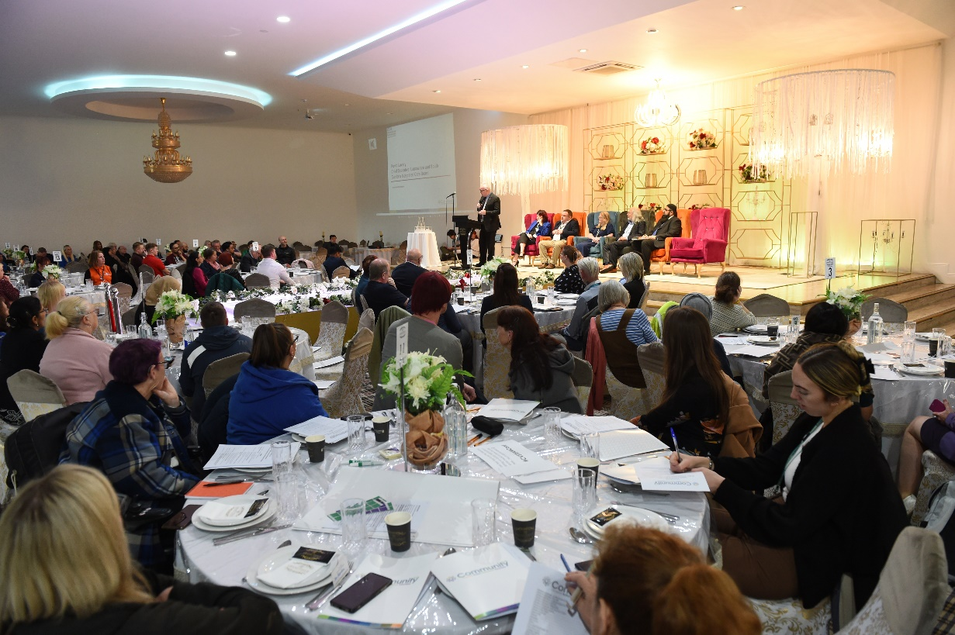
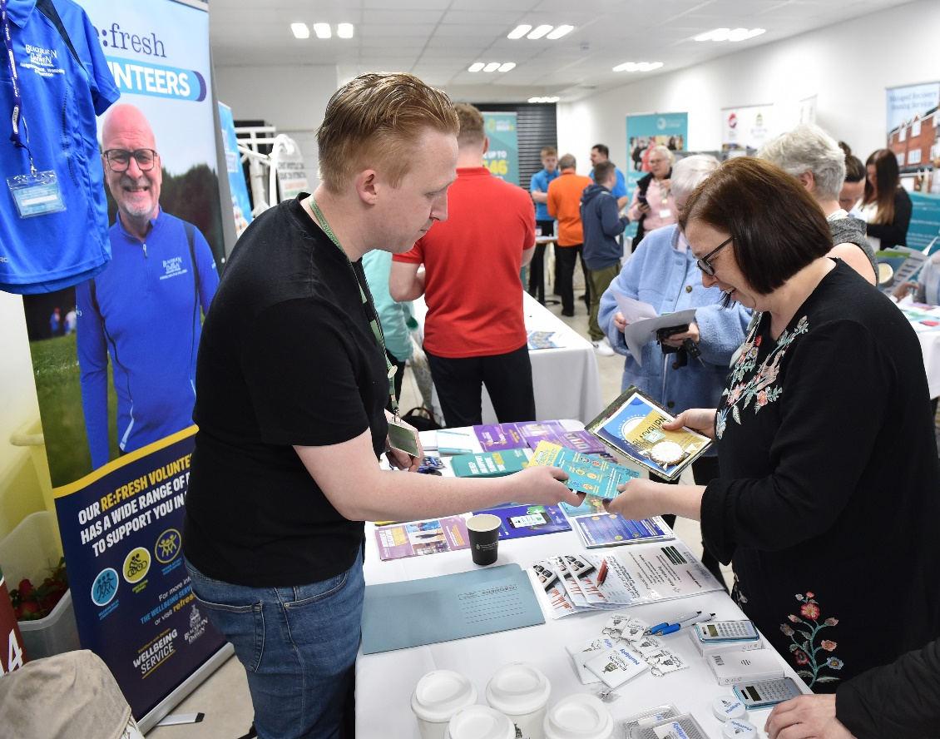
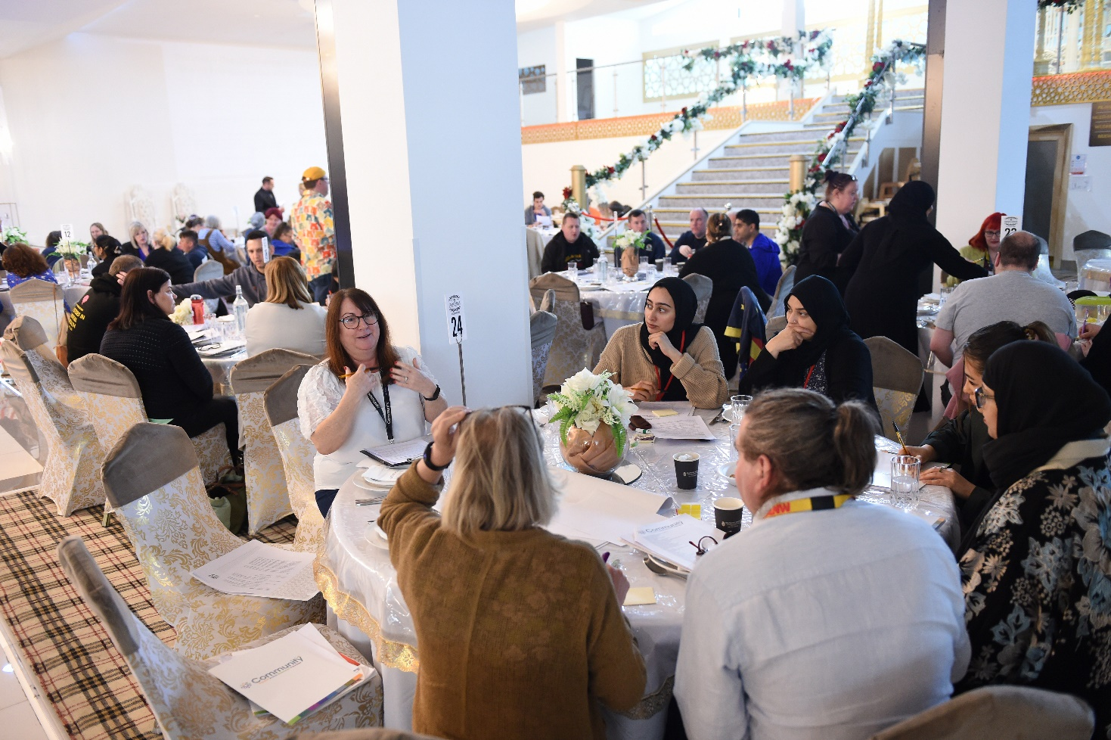
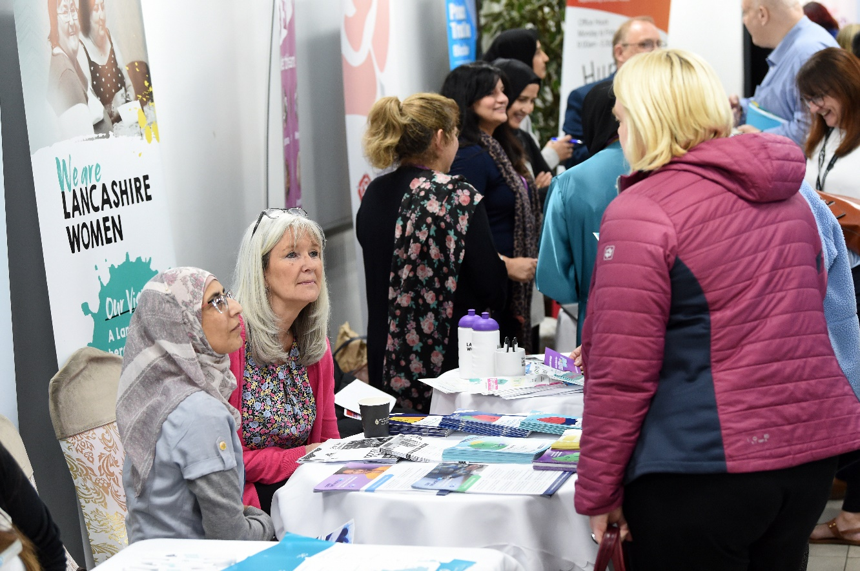
Blackburn with Darwen Community Network – the Journey so far
Community CVS
Together Everyone Achieves More Conference the Grand Venue, 10th May 2023
‘WHERE IT ALL STARTED’

Slide 3
Together Everyone Achieves More Conference: A Reminder
Over 300 people across VCFSE Sector
Key Speakers:
Cllr Phil Riley; Denise Park – Council Missions
Kevin Lavery; Claire Richardson – Health Transformation.
3 Discussions
1: Listening and Discovering what you think the future priorities for the VCFSE Sector should be?
2: Intro the BwD VCFSE Assembly or Alliance idea. Is this something the VCFSE Sector wants to create?
3: What is currently troubling your organisation (that CVS can help you with) and what BIG Ideas do you have to support the VCFSE Sector to develop and grow?
Vote: 97% yes to set up new entity.
Name: 51% BwD Community Network.

Slide 4
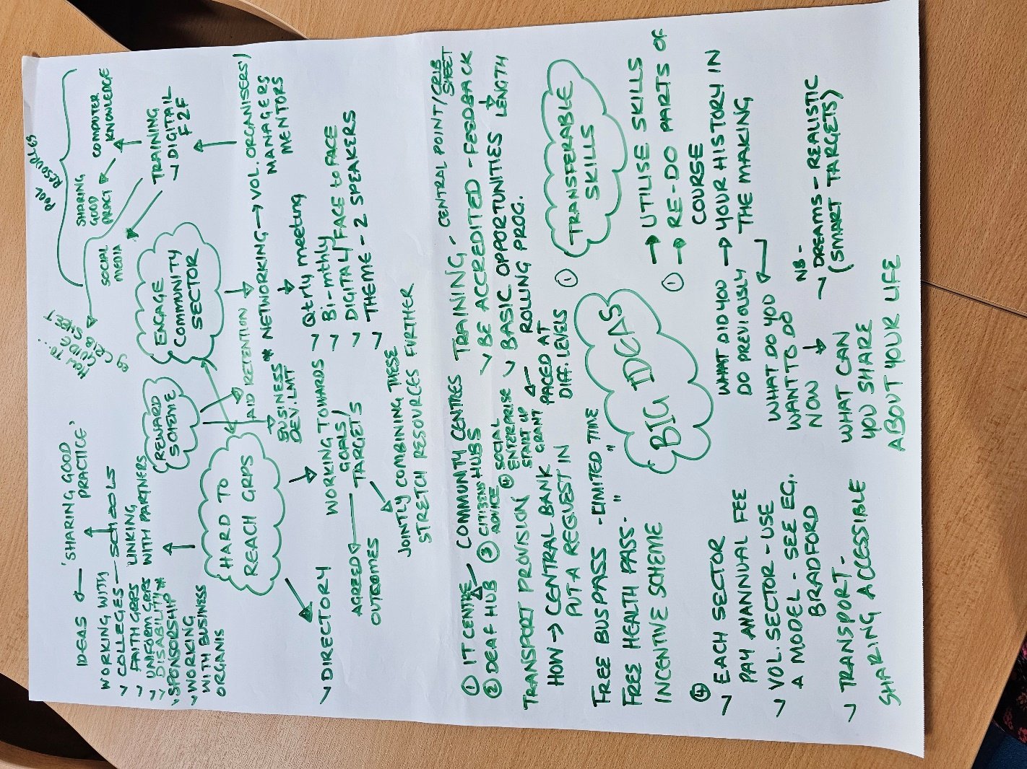
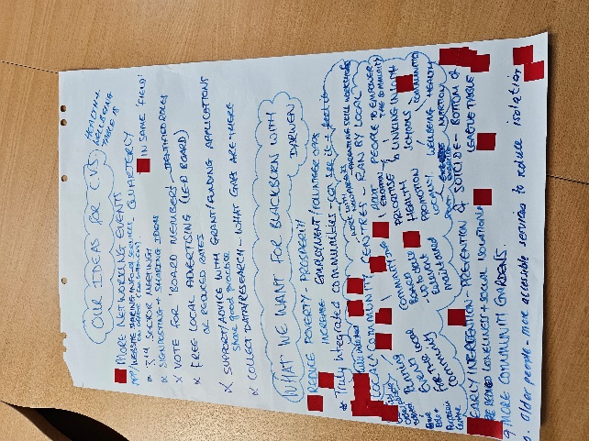
Some Feedback from the 1st Conference
“Want annual conference … but also want more frequent meetings on relevant topics. Lots of sub-groups via themes”.
“Want connections and link up the various networks / forums / etc”.
Want greater connectivity at neighbourhood level:
“Is there a possibility of something ward based that feeds into borough wide.
Locally would benefit smaller groups and be more helpful for them and understand processes better.”

Slide 5
THE PAST 12 MONTHS (July to Dec 23) Setting up the Network
2023 July Set up Development Group (20+ VCFSE organisations)
- Draft Purpose, Principles, Functions
2023 Sept 1st quarterly meeting of Community Network
- Agree Purpose, Principles, & CN Functions
- Agree to have a board, board composition & recruitment process.
2023 Oct Development Group re-draft Secretariat Functions
2023 Nov/Dec Development Group finalise recruitment pack and interview panel.

Slide 6
THE PAST 12 MONTHS (Jan to June 24)
2024 Jan 2nd quarterly meeting - Community Network
- Agree Secretariat Functions
- Agree for CVS to be the secretariat
2024 Feb Interviews for Board Places
21 applications; 17 interviews; 12 appointed.
2024 Mar Development Session for Community Network Board
2024 Apr 1st Community Network Board Meeting
- adopt Constitution
- discuss strategic framework and topics for 2nd Annual Conference
www.communitycvs.org.uk/action/bwd-community-network/

Slide 7
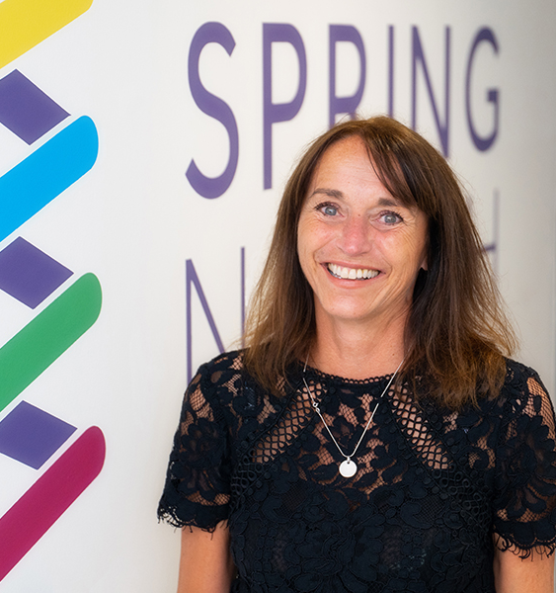
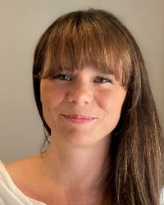
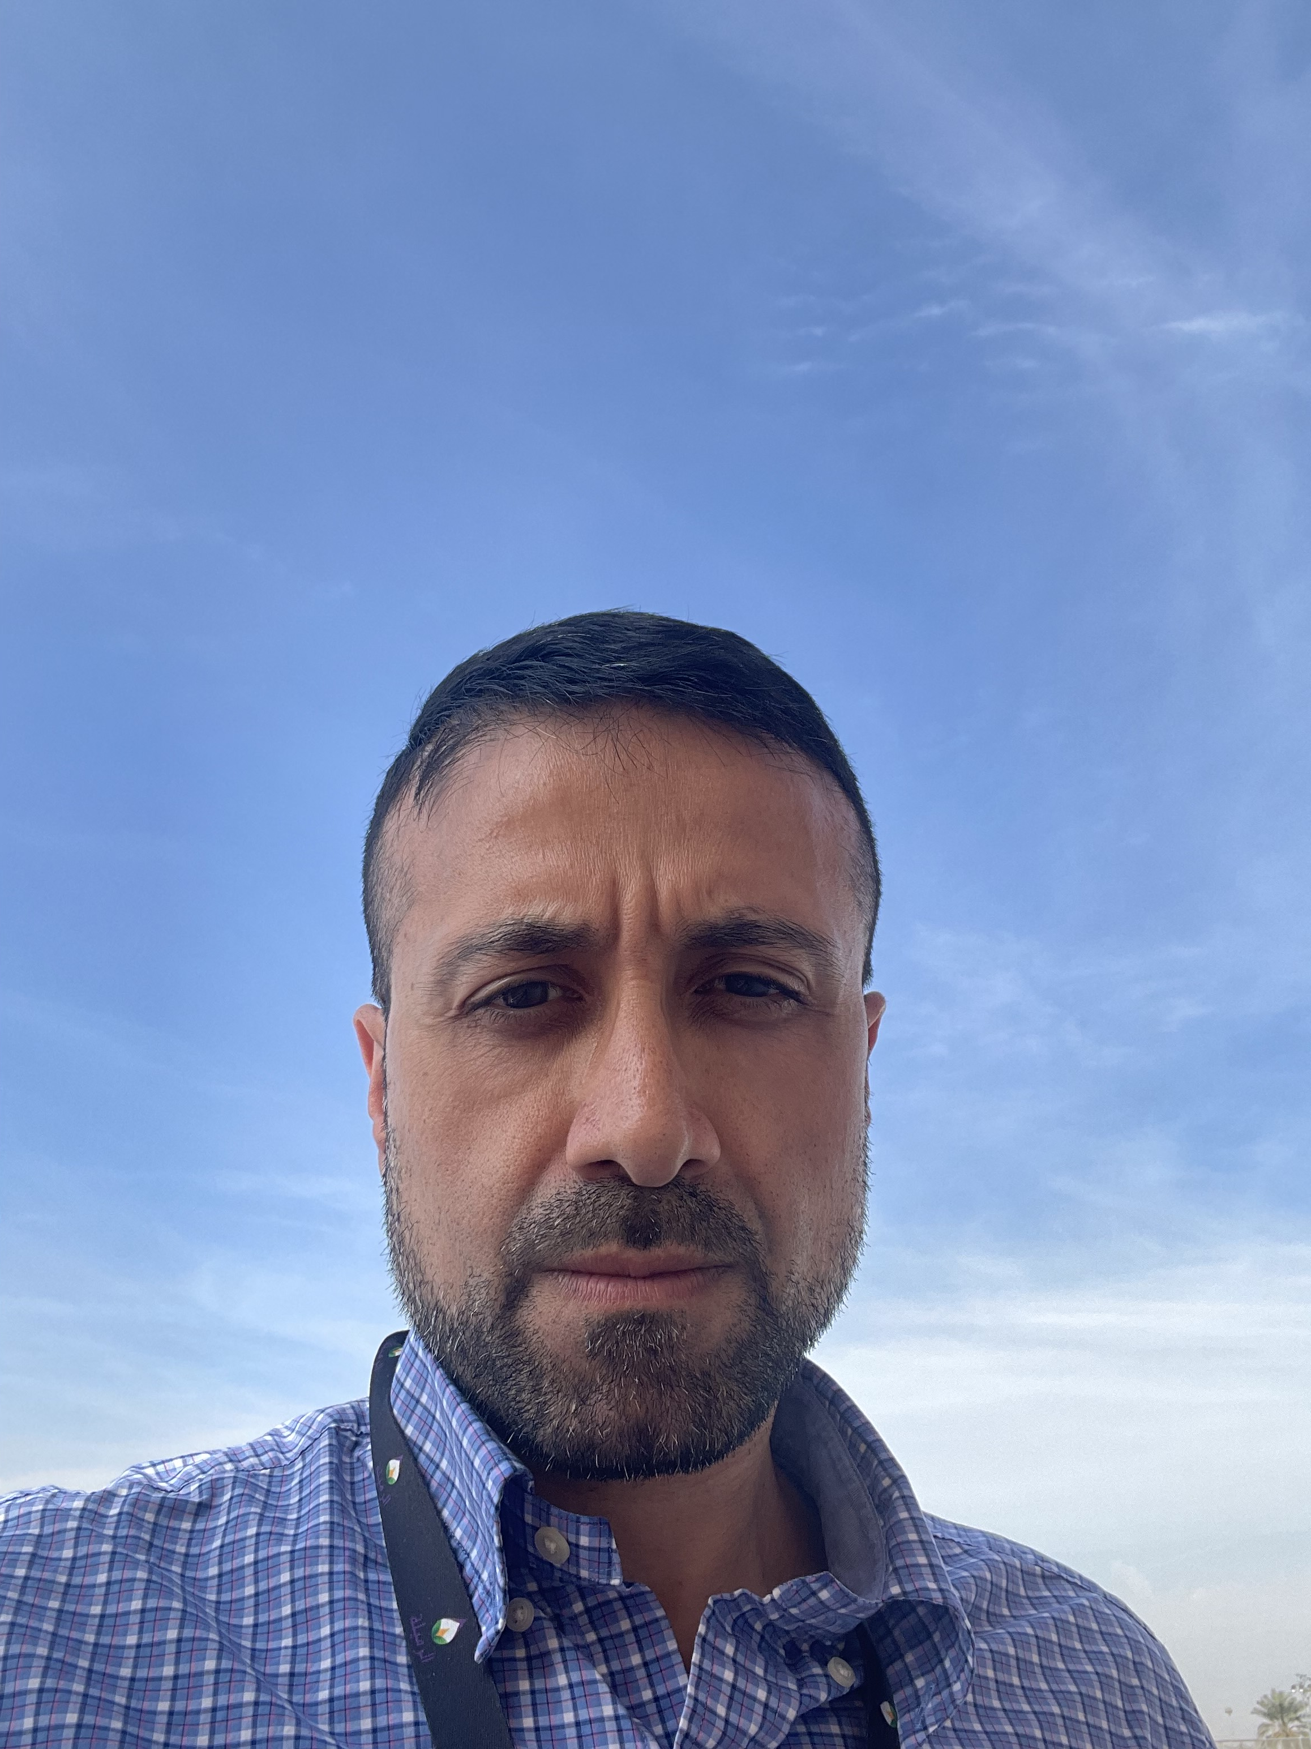
INTRODUCING THE NEW BWD COMMUNITY NETWORK BOARD MEMBERS
Angela Allen
Spring North
Jawad Bhatti
Spark /Bloke Talk
Rolande Bradshaw
Red Rose Recovery
Rachel Davies
Newground Together

Slide 8
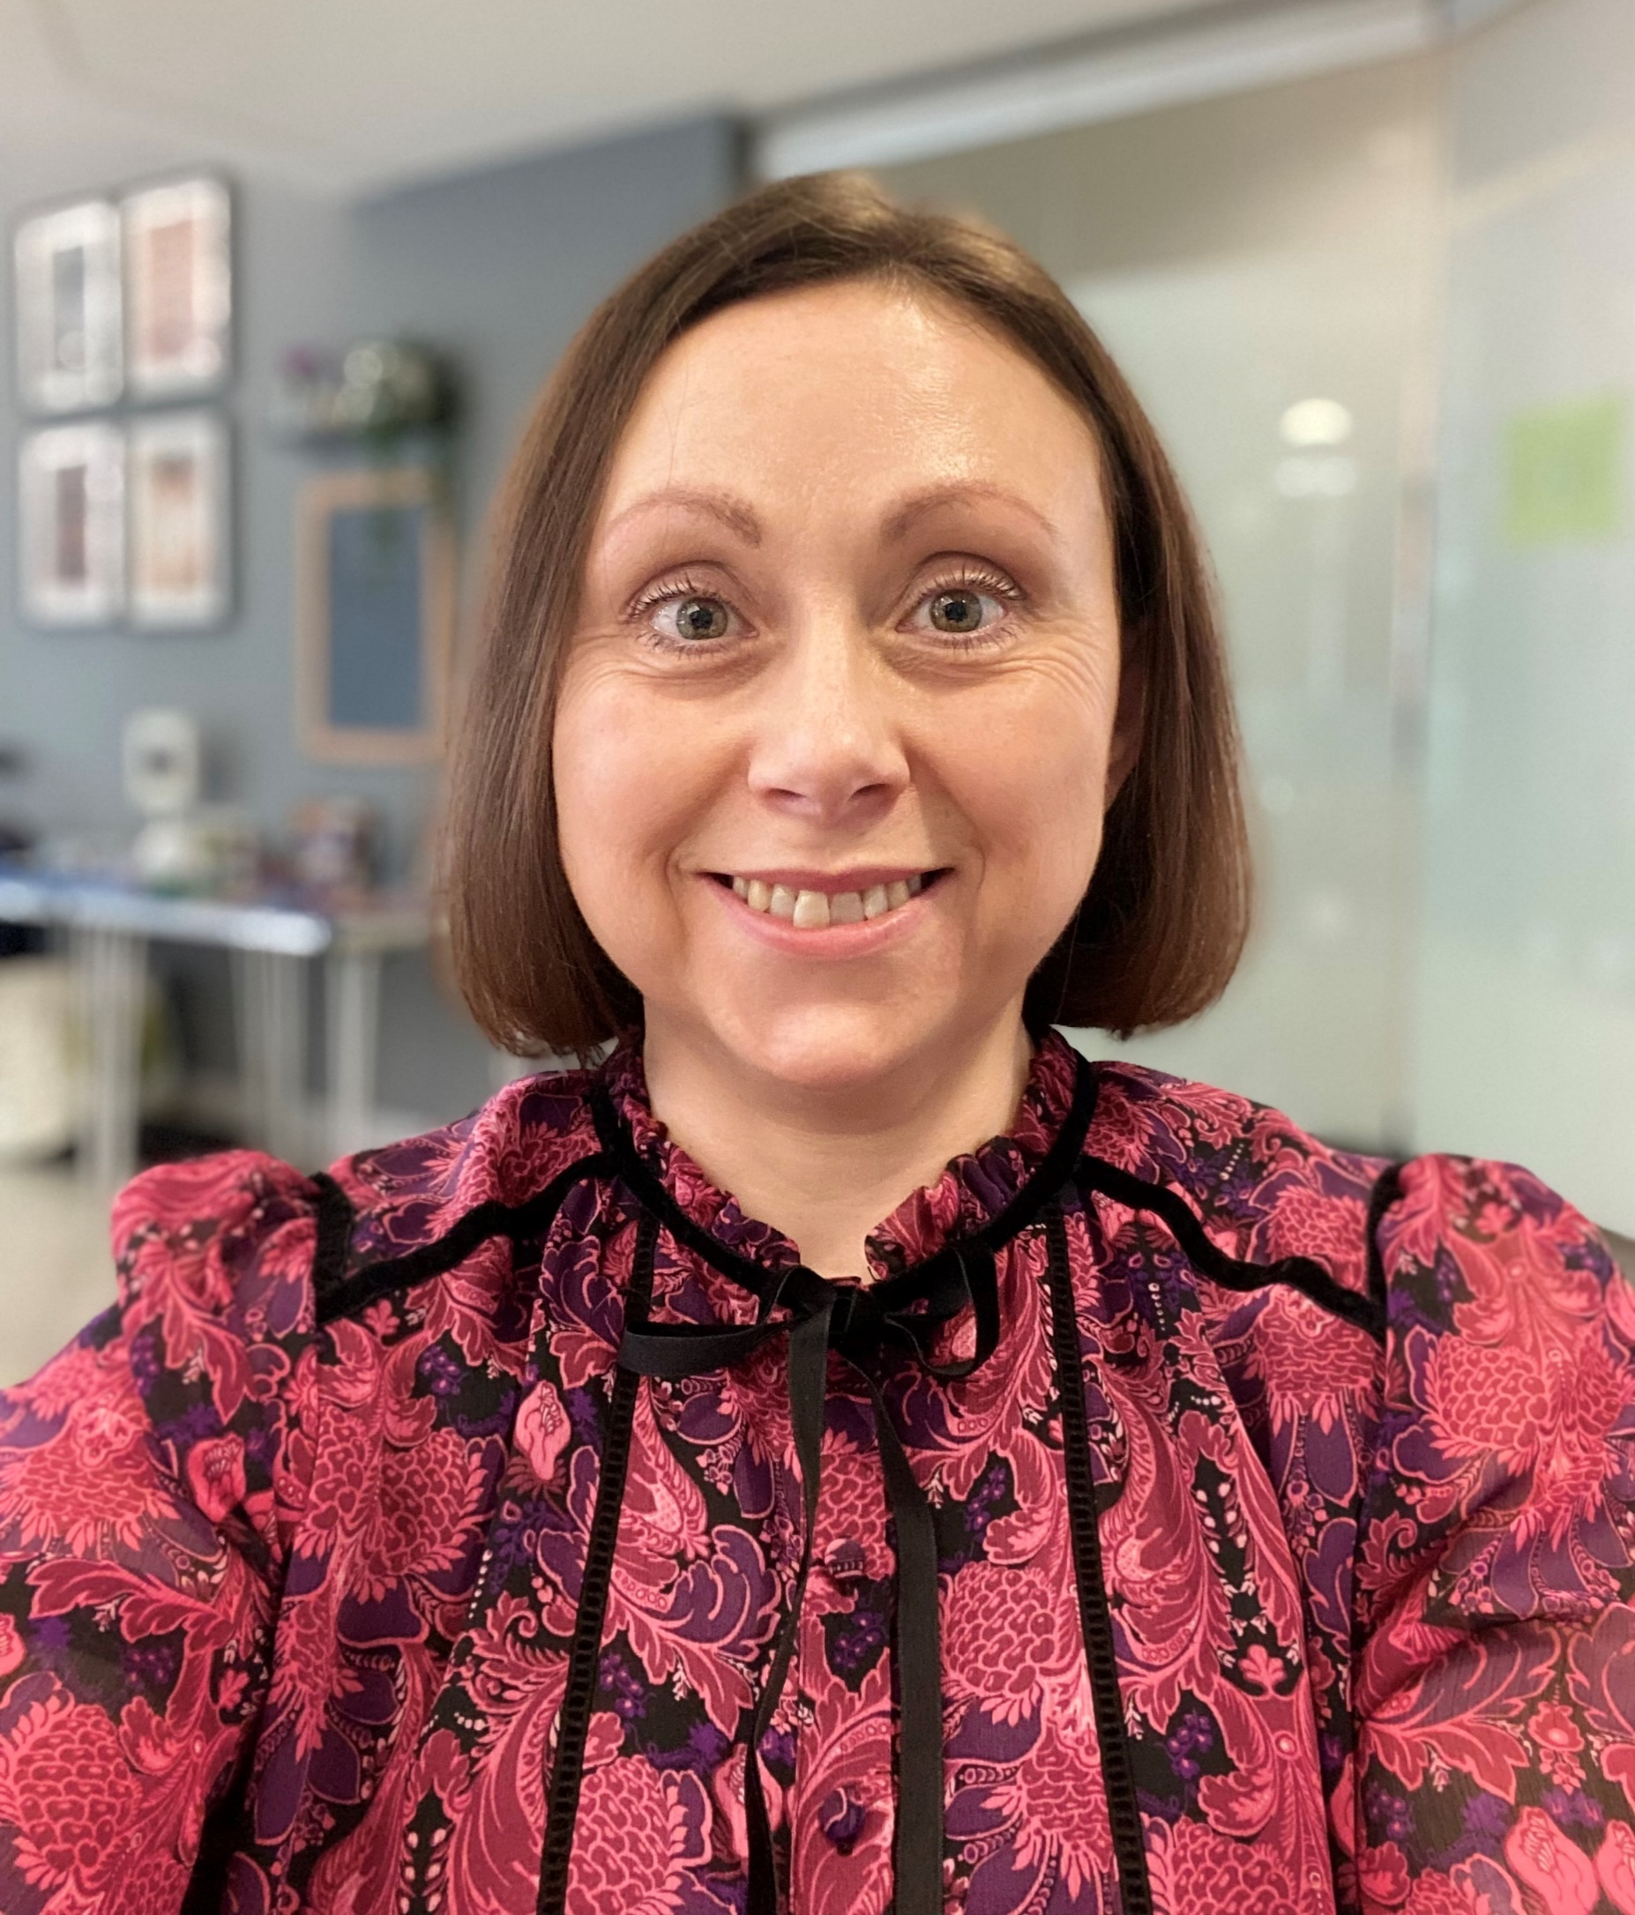
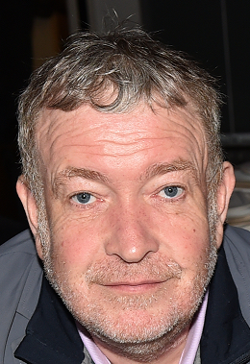
BWD COMMUNITY NETWORK BOARD MEMBERS
Hannah Goldthorpe MBE
James Hadleigh
Care Network
Shigufta Khan
The WISH CENTRE
Agnieszka Kwiecien
Q Language Services

Slide 9
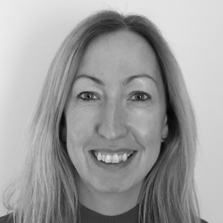
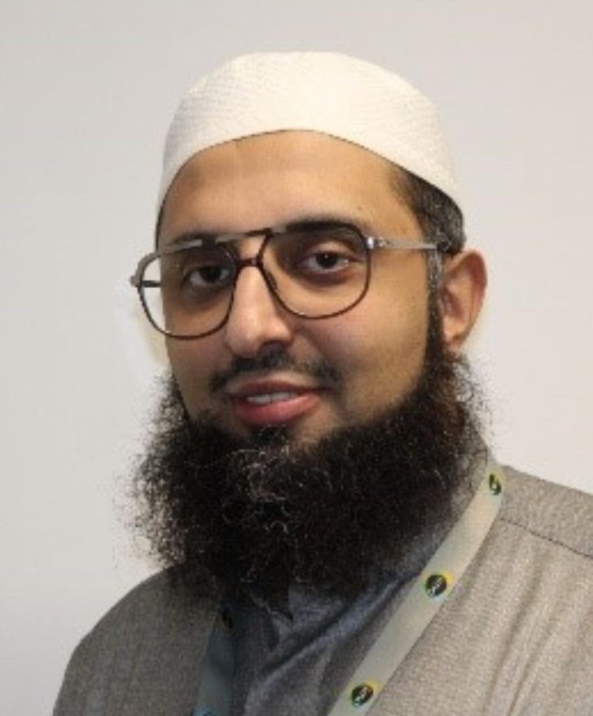
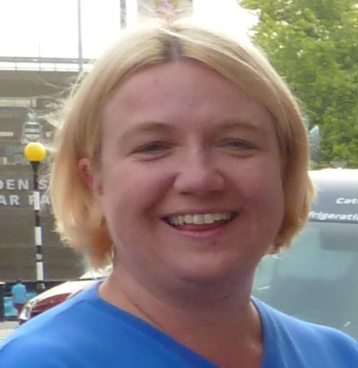
BWD COMMUNITY NETWORK BOARD MEMBERS
Donna Merton
Deaf Village
Suzanne Murray
Lancashire Women
Mohammed Sidat IMO
Vicky Shepard
Age UK BWD

Slide 10
THE SIX Ps
Social, Economic and Environmental Well-Being
People
Place
Participation
Prosperity
Planet
Peace

Slide 11
PEOPLE: TODAY’S TOPIC?
Health: How do we add healthy years to life in Blackburn with Darwen?
Hornby Lecture Theatre
Life Expectancy is falling.
Healthy Life Expectancy is falling.
How do we reverse these trends and especially for population groups experiencing the greatest health inequalities?

Slide 12
PEOPLE: POTENTIAL FUTURE TOPICS?
Start Well
Link to Families Hubs – to give everyone best start in life?
Link to Young People’s Foundation – to improve our youth provision?
Specific focus on Child poverty? SEND? LAC? Care Leavers?
Live Well / Work Well
Unemployed / economically inactive? Working poor?
Adults facing multiple disadvantage (addiction, Homelessness, CJS, MH, DA) Asylum Seekers and Refugees?
Carers, adults with LD, Mental health, adults with LTCs, etc.?
Age Well / Die Well
Frailty? Dementia? Loneliness? End of Life…?
What population groups should we prioritise?
Are there other specific population groups (Core 20 Plus 5)?

Slide 13
PLACE: TODAY’S TOPIC
How do we find and support our hidden populations?
Maslow’s Hierarchy of Needs
How do we identify and engage with people who are isolated or vulnerable to be noticed, connect, be active, volunteer, learn to maximise their potential? Meeting Room 3
What do places mean?
Belonging, Identity, Pride, Home; but also …
Shelter, safety, warmth, healthy environments

Slide 14
PLACE: POTENTIAL FUTURE TOPICS
Multiple Deprivation: What is our approach to improving lives within our most deprived neighbourhoods? How do we link population health and to economic and environmental interventions at the neighbourhood level? Do we need a community renewal programme?
Housing and Houses of Multiple Occupation (HMOs): How do we eradicate homelessness and help people to move out of the many houses of multiple occupation into decent homes?
Identity and Image: How can we use our arts and cultural assets, recreation and sports assets, and social assets (many of which are within the VCFSE Sector) to promote the Borough as a vibrant and active place to live or visit?

Slide 15
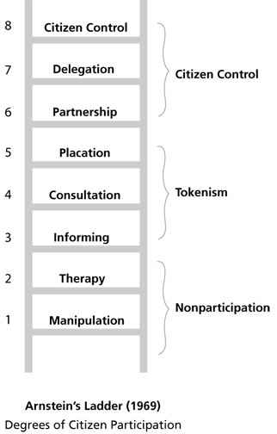
PARTICIPATION: TODAY’S TOPICS
How do we remove barriers and close gaps in participation?
Participation & Equity – how do remove barriers so that everyone from whatever their background can get involved and feel part of our communities? Meeting Room 1
Participation & Digital Inclusion – how do we fix the digital divide? – Meeting Room 2

Slide 16
PARTICIPATION: POTENTIAL FUTURE TOPICS
Participation in the arts & culture, recreation and sports and social activities
Participation through volunteering
Participation in Co-production on Public Service Improvements and participation in Decision-Making processes.
Achieving Social, Economic, Environmental Participation and Inclusion for All.

Slide 17
PROSPERITY: TODAY’S TOPICS
What pathways of support can we put in place to help people move from where they are currently to improving their financial status?
Prosperity 1: how can the VCFSE work together to help people experiencing the cost of living crisis to build their financial resilience and improve their household income? – Hornby Lecture Theatre
Prosperity 2: Volunteering and Employability – how do we use volunteering to improve people’s employability? Meeting Room 2

Slide 18
PROSPERITY POTENTIAL FUTURE TOPICS
Enterprise: how do we help more people from diverse backgrounds to set up in business or social enterprise if they want to?
Employment: how do we help the 1/3rd of the adult population not economically active or employed into work if they want to; how do we improve income and job security for those in work and increase their income levels? Employment Charters and Decent Meaningful Work.
Skills: how can the VCFSE Sector build the confidence of young people’s or adult’s and support them to develop the skills and experience to develop career paths that will realise their economic aspirations and dreams
Financial Resilience: how do we eradicate poverty?
Community Renewal: Do we need a community renewal programme to support our most deprived areas?

Slide 19
PLANET: TODAY’S TOPIC
Planet: how do we mobilise our communities, especially those in poverty and disadvantage to take action around climate change and the environment? Meeting Room 1
People’s Jury on Climate Change (2023) Recommendations:
1st Communication and Education: “We have learned a lot through being involved in the Climate Change People’s Jury. Everyone can be educated through inclusive involvement about how to make Blackburn with Darwen a better place to live, work and play.”
2nd Accountability for individuals and organisations on progress.
3rd = Improve green spaces around the Borough.
3rd = Food Waste.

Slide 20
PLANET: POSSIBLE FUTURE TOPICS
Natural Assets/Capital: Can we help in investing in our parks, natural assets, open green spaces to help biodiversity, tree planting, etc?
Sustainable Food Place: how do we support the BwD Food Alliance to make BwD a sustainable food place?
Circular Economy: how do we lead a joint effort across public, commercial and social economies/sectors to promote local procurement, more recycling/reuse, etc…
Sustainable Development within the VCFSE Sector: how does the VCFSE Sector move towards net zero?
Are there other elements of the climate emergency or planet related issues that we should focus on?

Slide 21
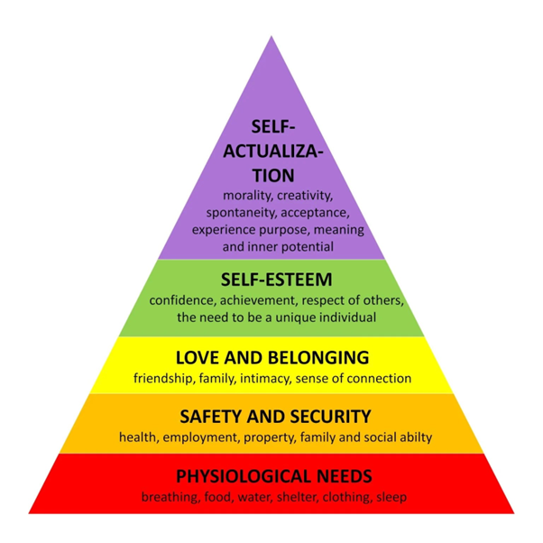
PEACE: TODAY’S TOPIC
Peace: how do we create a community which is free from violence and where everyone is safe and respected? Meeting Room 3
What does it mean?
Peace impacts: on
Self-esteem & respect
Love and belonging
Safety and security
Basic physiological needss

Slide 22
PEACE: POTENTIAL FUTURE TOPICS
Cohesion and Integration? How do we build cohesive, integrated communities and create a welcoming place for diverse communities to live in harmony and peace?
Domestic Abuse? Can we do more by working together to eradicate domestic abuse?
Eradicating Discrimination & Promoting Equity?
Road Safety? What can we do together to improve road safety?
Violent Crime? Can we do more?
Are there other topics around Peace (basic needs, security & safety, love & belonging, self-esteem and respect)
that we should focus on?

