Slide 1
Working towards the priorities of:
A NEW VCFSE PROJECT FOR LANCASHIRE,
BLACKPOOL, BLACKBURN WITH DARWEN, FYLDE & WYRE (Lancs 14)
The ‘LOCAL’ Project

Slide 2
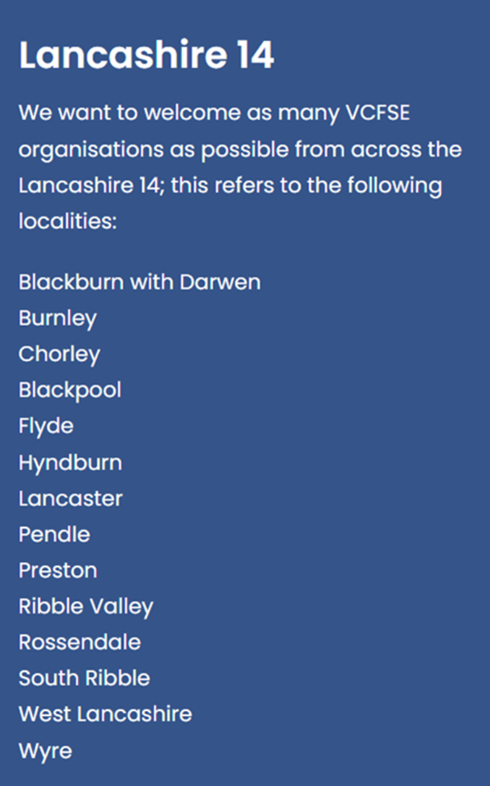
LOCAL – stands for Locally Organised Communities Across Lancashire (14)

Slide 3
The LOCAL project is managed by the Lancashire Association of CVSs (LACVS)
LACVS is a registered charity and Company Limited By Guarantee
Existed for over 15 years.
Works closely with local members, voluntary, community, faith and social enterprise organisations (VCFSE) and have a reach to over 4000 VCFSE organisations.
LACVS aims to add value to what our members do and help them to lead positive change.
Has ambitious plans to deliver the VCFSE Manifesto and help the VCFSE Sector to tackle the issues our communities face.
LACVS is an umbrella organisation which offers support and development capacity to the VCFSE sector across the Lancashire 14 area.
The LOCAL project is funded by The National Lottery Community fund for 5yrs years.

Slide 4
The VCFSE Manifesto for Lancashire 14 was facilitated by VSNW (Voluntary Sector North West) , produced in a 12-week engagement and series of sector wide conversations - the participants called for:
An Equal & Fair Lancashire 14
Community Wellbeing
A thriving Local Economy
Adequate Resourcing for the Sector to Achieve its Goals

Slide 5
The LOCAL project will work within the VCFSE sector and alongside our public sector partners to:-
Listen to our communities to identify gaps in services and the need for local changes
Research and evidence gaps in local networks & those across Lancashire 14
Advocate for the change that needs to happen
Work with partners seeking the resources for them to make change
Further VCFSE engagement and participation across Lancashire 14 then developed the manifesto into 9 priorities.

Slide 6
The 9 Priorities of the Manifesto
The LOCAL project will be guided by the Lancashire 14 VCFSE Manifesto to deliver impactful changes across 9 priority themes:
Equality and Social Justice for All: Tackling Poverty in Lancashire
VCFSE Sector as an Equal Partner
Economic Model That Works For Lancashire
Community wellbeing and person & community-centred Public Service Models
Green Communities
Pioneer a Lancashire Social Prescribing Model
A Safer Lancashire
Helping People into Employment
Adequate VCFSE Resources to play our full part in the future of Lancashire

Slide 7
Early Steps to Aid Partnership & Collaboration.
Establish a baseline of the number and type of VCFSE organisations currently known of across the Lancashire 14
Identify the estimated 1000’s of groups not yet connected into the VCFSE sector.
Starting conversations within and across areas to identify potential collaborations and partnerships filling gaps in services which will encourage investment in the sector
Deliver conferences, events and workshops to feed into evidence-based reporting to produce collaborative action
Gathering sector intelligence and disseminating across VCFSE organisations
Engage with funders to encourage investment in Lancashire 14 areas

Slide 8
Thank You For Listening.
We are here all day to chat with you
For further information please contact:
Greg Mitten, Lead Co-ordinator - greg.mitten@lacvs.org.uk
Denise Hayhurst, Place Co-Ordinator – denise.hayhurst@lacvs.org.uk
Rachel Coupe, Place Co-Ordinator
Rachel Wheble, Place Co-Ordinator

