Slide 1
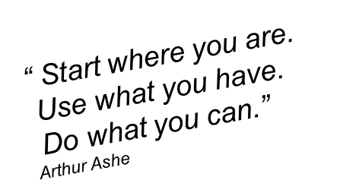
The resilience workshop teaches delegates about the basic principles of resilience, and explores how these principles can help you to become more productive and resilient to burnout.
Course description
Building your resilience can help when you need to adapt well in the face of adversity, threats, or even significant sources of stress — such as family and relationship problems, serious health problems, or workplace and financial.
Cost = £150
Who should attend?
This course is suitable for anyone who wants to strengthen their inner drive and coping mechanisms to avoid the chance of burnout and illness, increasing their productivity.
What you will learn
Understand what resilience is and how to develop your resilience
Have tools to support your wellbeing
Take time to “Think about me”
Form a “Healthy Habit”

Slide 2
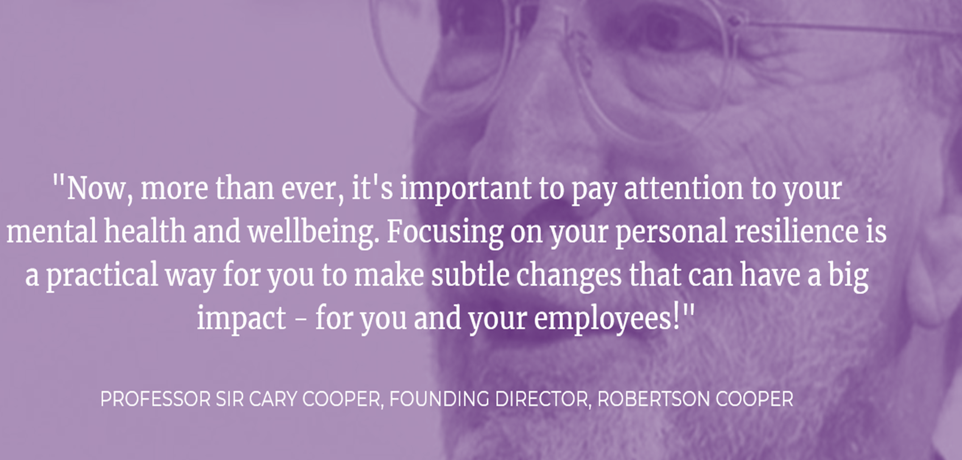
These bite size sessions will take place over 4 weeks from
09:30 – 11:00 starting on Wednesday 3rd November.
Resilience | Wednesday | 3rd | From 9:30 – 11:00
Mental Wellbeing |  | 10th
Self - Care |  | 17th
Healthy Habit |  | 24th
To gain the full benefit of the workshop, you must be available to attend all 4 sessions
The sessions will be delivered online via Microsoft Teams.
To book your place visit Active classroom sessions - Blackburn with Darwen Learning (melearning.university)
or please email: Amanda.Wilkinson@blackburn.gov.uk

