Slide 1
Blackburn with Darwen
Joint Health & Wellbeing Strategy
Local Public Service Board
30th April 2015

Slide 2
Joint Health & Wellbeing Strategy –
What is it?
The overarching plan through which the public, private, community and voluntary sectors, as well as residents themselves, will work together to improve health and wellbeing for and with local people

Slide 3
Our Approach
Tackle the wider determinants of health and wellbeing
Focus on things we can do together to make the biggest difference
Evidence based action across the life course
  Start Well (0-25yrs)
  Live Well (people of working age)
  Age Well (50+)

Slide 4
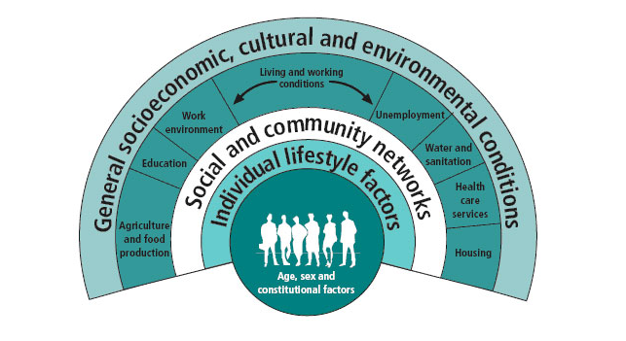

Slide 5
Blackburn with Darwen Health & Wellbeing Strategy 2015 - 2018
Challenges | Principles | Cross Cutting |  |  | Priorities
Poverty, deprivation and disadvantage Unemployment and worklessness Impact of alcohol Quality & diversity of housing Fuel poverty Health outcomes in children Premature mortality and disability from long term conditions Older people needing support to remain independent Social isolation | Work together Build on strengths (assets) Good governance Integration Addressing inequalities (fairness) Health in all policies including social value | Identification, prevention & early intervention | Positive mental health & wellbeing | Poverty & financial inclusion | Start well (0-25yrs): Ensure an effective multi-agency Early Help offer provides the right help at the right time Support families through a consistent approach to parenting skills and support Improve children and young people’s emotional health and wellbeing Embed routine enquiries about childhood adversity into everyday practice
 |  |  |  |  | Live Well (working age): Support opportunities for employers to improve workplace health and wellbeing Ensure people have opportunities to live in healthy homes and neighbourhoods Encourage people to take control of their own health and wellbeing
 |  |  |  |  | Age Well (50+): Develop BwD as a dementia friendly community Increase support to reduce social isolation and loneliness Tackle the wider determinants of health of older people including finance, employment, housing and fuel poverty Develop the local integrated service offer to promote independence

Slide 6
Blackburn with Darwen Health & Wellbeing Board
System Governance Structure
NHS England
Blackburn with Darwen Council
Executive Board
Overview & Scrutiny Committee
Local Strategic Partnership
Blackburn with Darwen
Health and Wellbeing Board
Blackburn with Darwen CCG
Governing Body
Clinical Senate
Commissioning Business Group
Quality Performance Committee
Blackburn with Darwen Adults & Children’s
Safeguarding Boards
Healthwatch Blackburn with Darwen
Virtual Executive & Officer Group supporting effective operation & ongoing development of the Board
Local Public Service Board
JHWS Delivery Groups
JHWS Programme areas 1-3:
Start Well: Children’s Partnership Board
Live Well: Prosperous Group
Age Well: 50+ Partnership
Joint Health & Wellbeing Strategy Leads Group
Quality & performance
JSNA Leadership Group
Integrated Performance Group
Integrated Commissioning
Executive Joint Commissioning Group
Joint Commissioning and Recommendation Group
Integrated Care Programme (0-25s, complex adults, frail elderly)
Locality delivery mechanisms to be agreed
Locality Delivery
North
Health & social care
Early Help
Transforming Lives
Locality Delivery
East
Health & social care
Early Help
Transforming Lives
Locality Delivery
West
Health & social care
Early Help
Transforming Lives
Locality Delivery
Darwen
Health & social care
Early Help
Transforming Lives

Slide 7
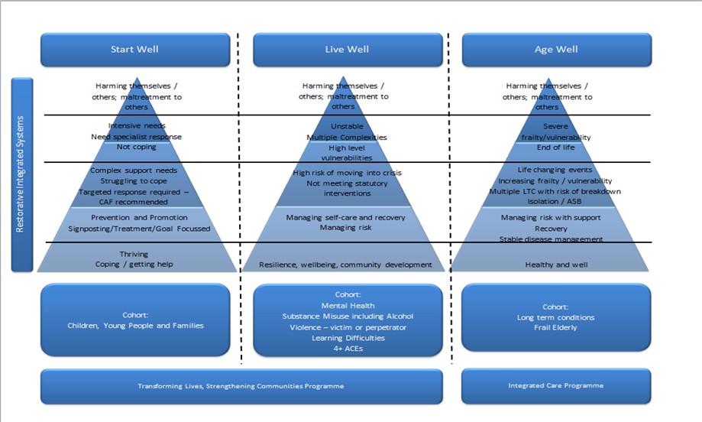

Slide 8
Early Action Vulnerability Step Down Model
Demonstrates level of support at each level of the Live Well Triangle
Statutory Support
Crisis Point
Complex support
Additional Support
Community Support
Fully Resilient

Slide 9
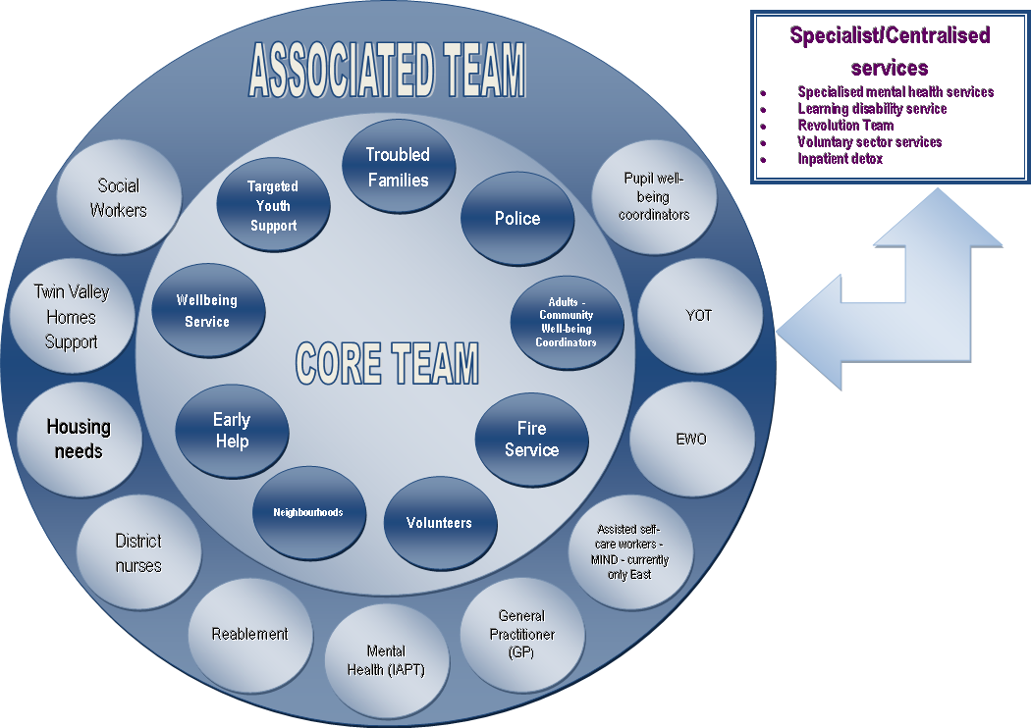
Transforming Lives Locality Team

Slide 10
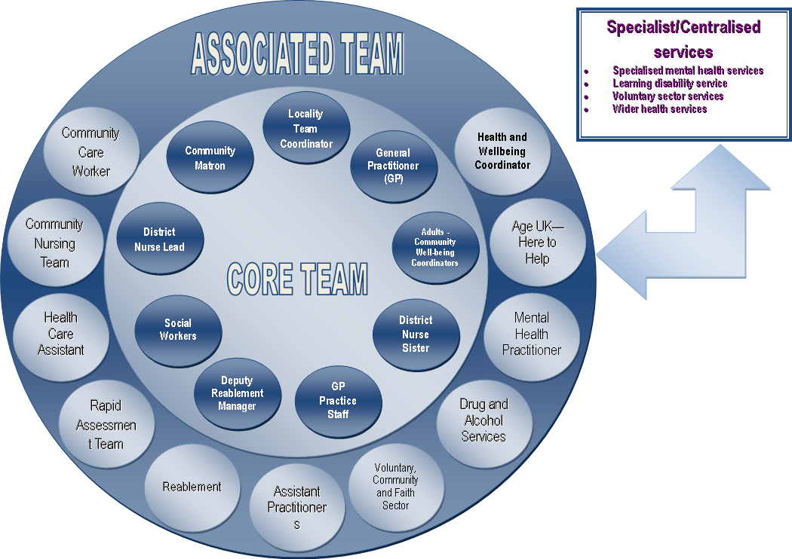
Integrated Care Locality Team

Slide 11
Locality Working: Process
Multi-agency Operational Process
  Weekly Referrals to a Multi Agency Panel
  Case management to understand whole needs of cases
Co-location of staff
  Enabled sharing of information to flow well across agencies
  Improved communication, energetic discussions
Cases have one named person
  Streamlined approach, less complicated
Notes:
Multi-agency Operational Process
Referrals are made to the Transforming Lives Panel
The Panel meets every week - Wednesday afternoon
Cases from Panel assigned to the Locality Team
Case management via Locality Team discuss new cases & existing cases where barriers identified
Format of weekly Case Management Meetings
Meets every Tuesday afternoon
All Key Workers holding live cases attend
Energetic discussions on cases
Format is working well and positive engagement
Establishment of working relationships across services
This has been achieved through co-location of staff
Information Sharing has begun to flow well from both Panel to Case Management meetings AND, within the Locality Teams

Slide 12
Transforming Lives Cases
487 referrals to Transforming Lives Panel (June 2014 – April 2015)
  72 referrals received April 2015
  60 active Transforming Lives cases in East locality
Key themes
Notes:
Additional pathways into TL panel have been developed over time and this is demonstrated by the increased number of referrals being received – i.e. 74 in March, 72 in April
Table highlights the top 6 themes identified on referral forms

Slide 13
ILT – progress to date:
Integrated Care Locality team activity - January 2015 – April 2015:
  792 cases discussed with GP Practices across BwD
  303 cases have been part of case management discussions at weekly integrated care team meetings across the 4 localities
  Please note - There is cross over between weekly and GP discussions

Slide 14
Locality Working: Challenges
IT
Element of the process can still be improved
Coordination and management of Locality Team
Step Down Approach
Notes:
IT
Access to own organisation’s systems within the building is limited
Wifi only just being installed to resolve some IT issues
Still need to have full integration of systems – so real time intelligence
Practical element of process could be improved
Case managers still have own organisational processes & systems for collecting case information, which differs from the Transforming Lives System
Scoping the different systems to understand the alignment
Coordination and management of Locality Team
Full time job – to include administration, coordination, support, team building, connectivity to other services
Prioritisation of work force development activity has been challenging due to diary commitments and other pressures within the system
Step Down Approach
Also has a Step-Up element at times – this is being closely monitored

Slide 15
Locality Working: Strengths
Positive coordination and simplicity of service provision for the people of BwD
Integration of care, within both team and between Transforming Lives / Integrated Care Locality Teams
More organisations / services interested
Workforce Development Participation – engaging and positive
Notes:
Positive coordination and simplicity of service provision
People are engaging with the process
Improving outcomes for families, children and individuals
Improved their lives
Relationships with Integrated Care Locality Teams
Positive Progress made between Transforming Lives & Integrated Care Locality Teams
Truly integrated package of support
More organisations / services interested
Expressed interest in our integrated approach and interest to participate
Workforce Development
Participation from Locality Teams has been engaging and positive
Key topics included: developing relationship; Safeguarding; REACh (ACE); ABCD (asset based community development)

